Slide 1
Intro to Unity
for MR development on the
Magic Leap One
Natalie Perez
NPerez@NEDDTech.com

Slide 2




The NEDD Tech Team
Natalie Perez Evelyn Skinner Dave Noderer Dwight Goins
Notes:
At NEDD Tech we provide training and consulting, and app development.
Bio:
Self taught programmer
Focus on AR/VR/MR development using Unity
Teaching:
SF code camp and others
WebDev TF
Code Art Instructor
Girl Develop It Orlando courses
Meetups, events, and exhibits at conventions
SimBlocks
Military training simulation with COTS game engines

Slide 3
Link to Slides:
goo.gl/o8e54h
Notes:
goo.gl/o8e54h

Slide 4
Today’s Agenda
What is AR/VR/MR
Magic Leap Package Manager
ML Remote
Unity Hub
Creating a new project
Unity interface
Mixed reality and build settings

Slide 5
Agenda cont...
Creating a game object
Adding a script to an object
Play mode to test your app
How to download/import from the asset store
Apply materials on a game object
Terrain Engine

Slide 6
Tutorials
Unity
https://unity3d.com/learn/tutorials
Magic Leap
https://creator.magicleap.com/learn
Windows Mixed Reality and HoloLens
https://developer.microsoft.com/en-us/windows/ mixed-reality/academy
Notes:
Unity:
https://unity3d.com/learn/tutorials
Magic Leap:
https://creator.magicleap.com/learn/tutorials
Mixed Reality and HoloLens:
https://developer.microsoft.com/en-us/windows/mixed-reality/academy

Slide 7
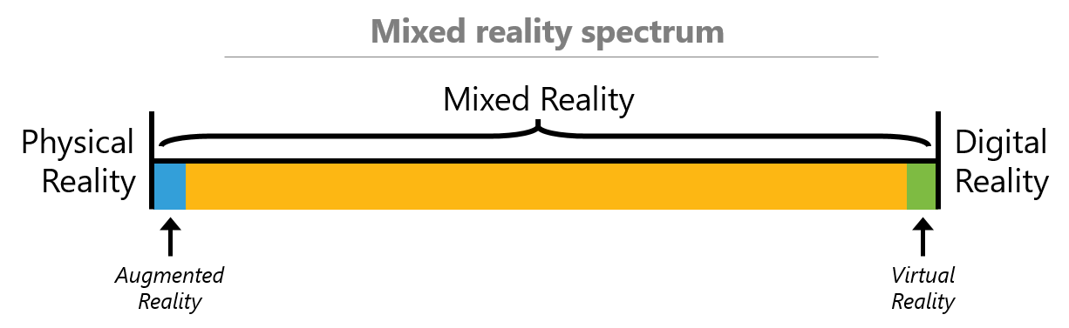
What is VR/AR/MR
Notes:
Image source: https://developer.microsoft.com/en-us/windows/mixed-reality/mixed_reality

Slide 8
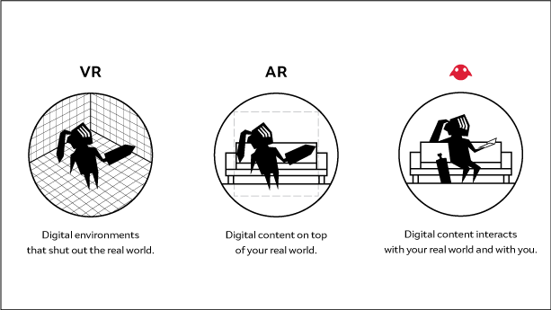
Notes:
Image source: https://creator.magicleap.com/learn/guides/core-mixed-reality-principles

Slide 9
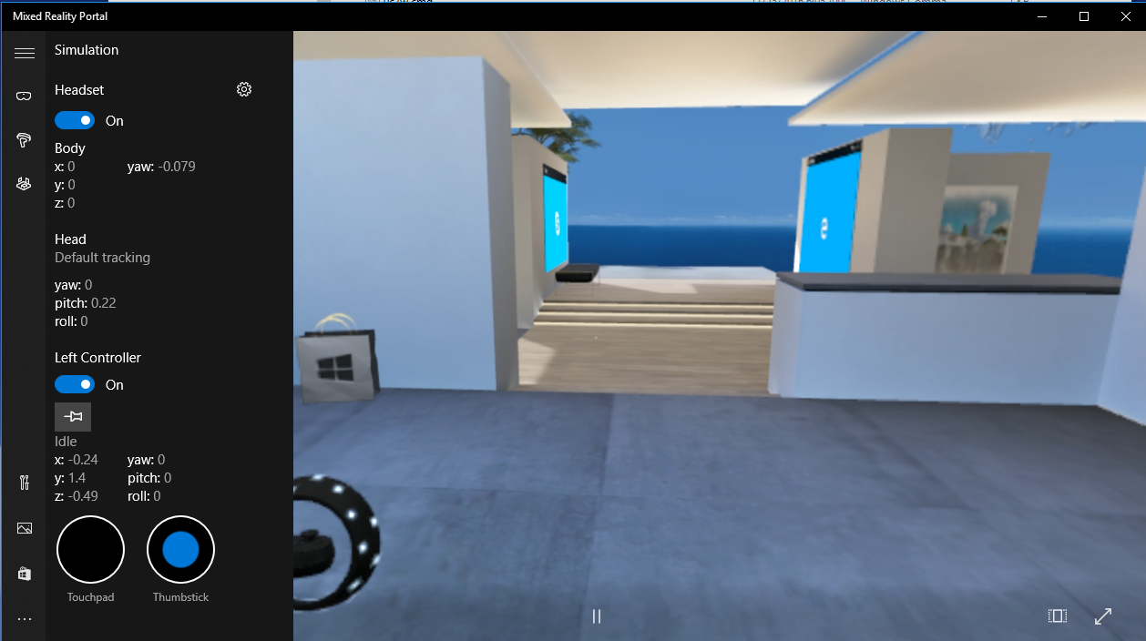
Mixed Reality Portal
Notes:
MR portal is for the Windows Mixed Reality headset. Magic Leap uses the ML Remote.

Slide 10
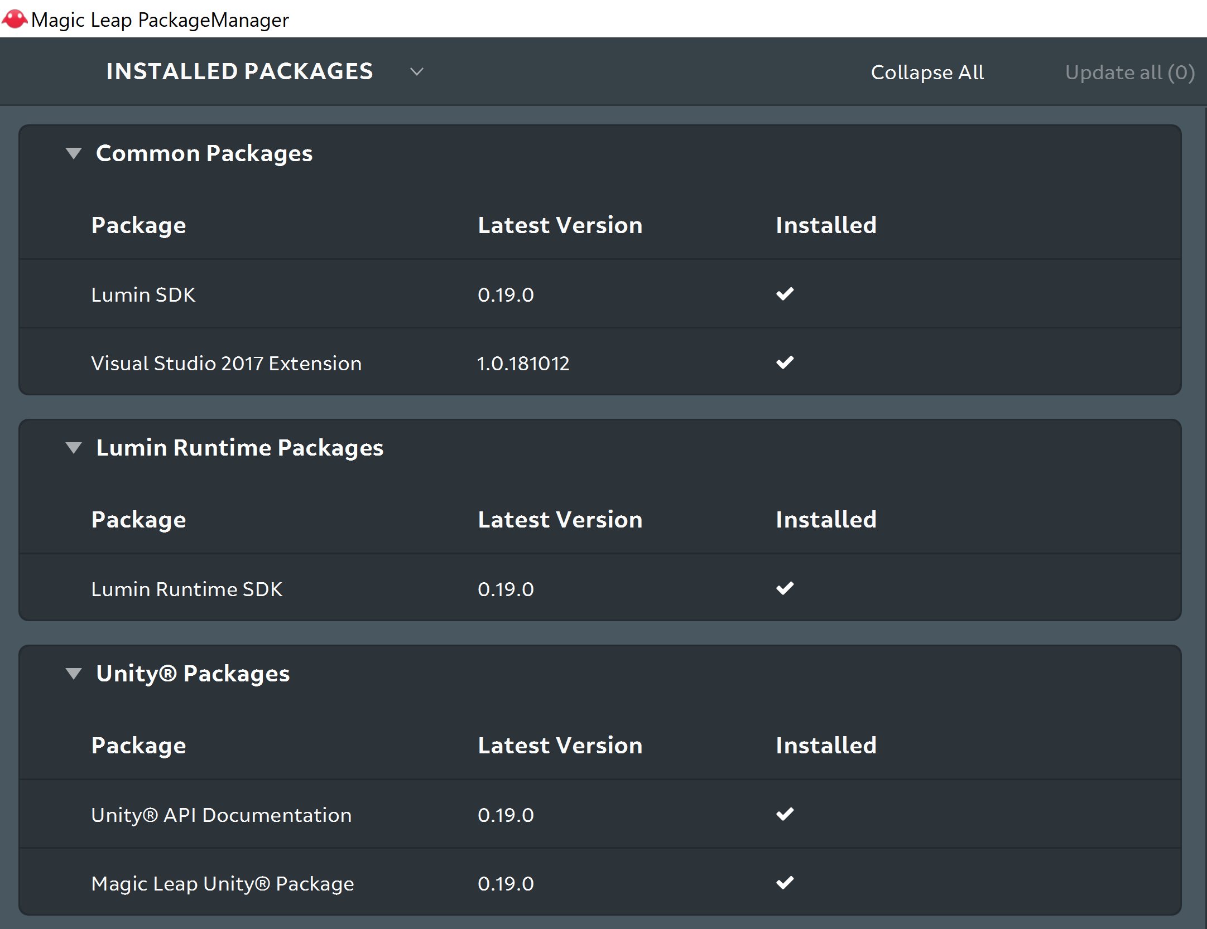
Notes:
Start by opening the Magic Leap Package Manager --> ML Remote first then Unity, otherwise you may run into some issues/bugs.
If you’ve already installed packages, make sure to select Update all when needed

Slide 11
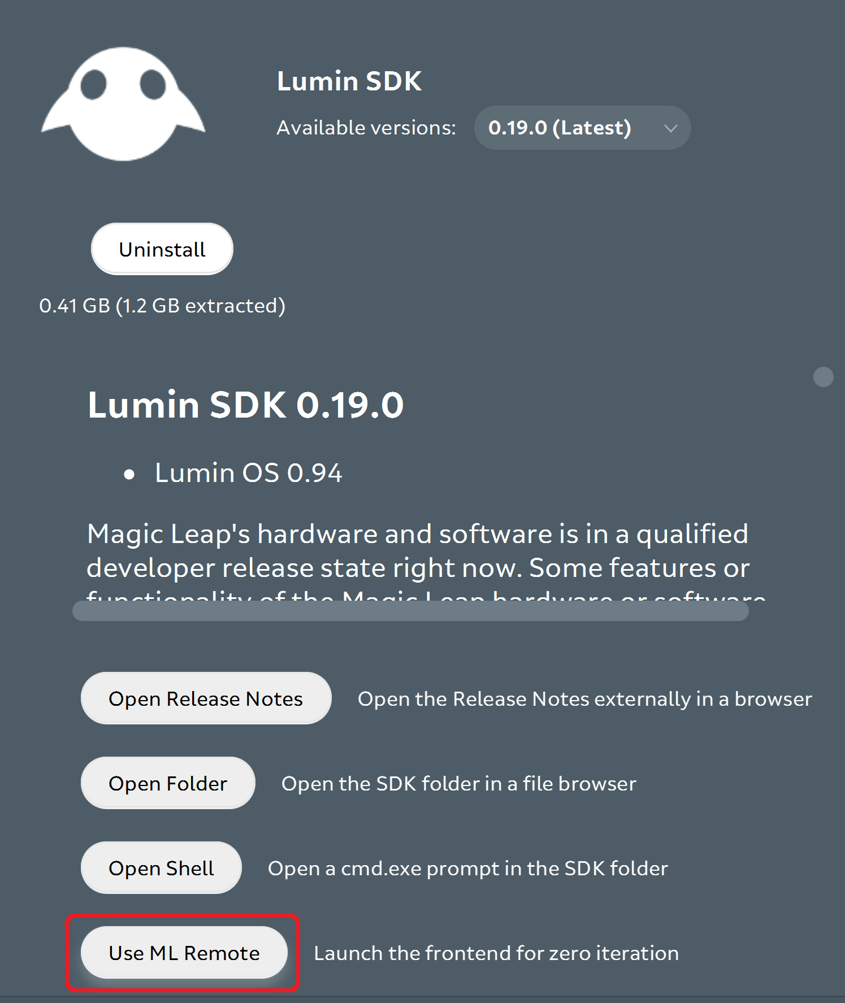
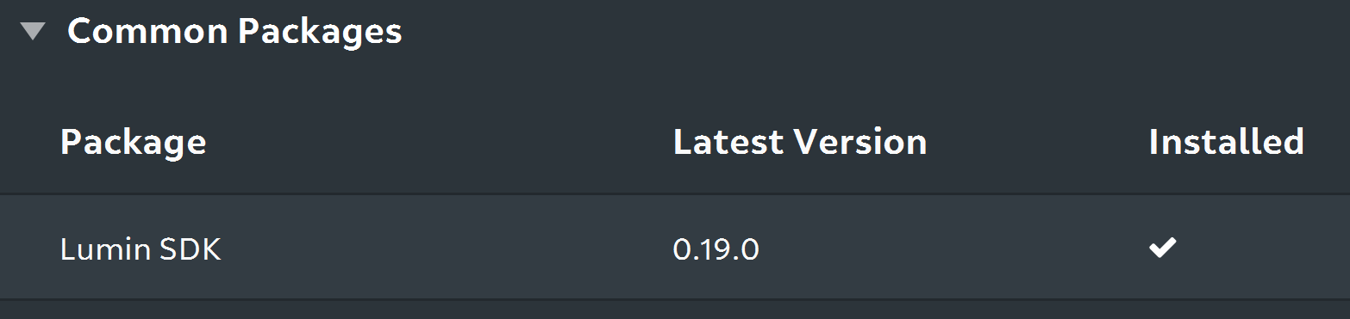
ML Remote
Notes:
Open the ML Remote.
If you forget where you saved the SDK, you can click Open Folder to be directed there.

Slide 12
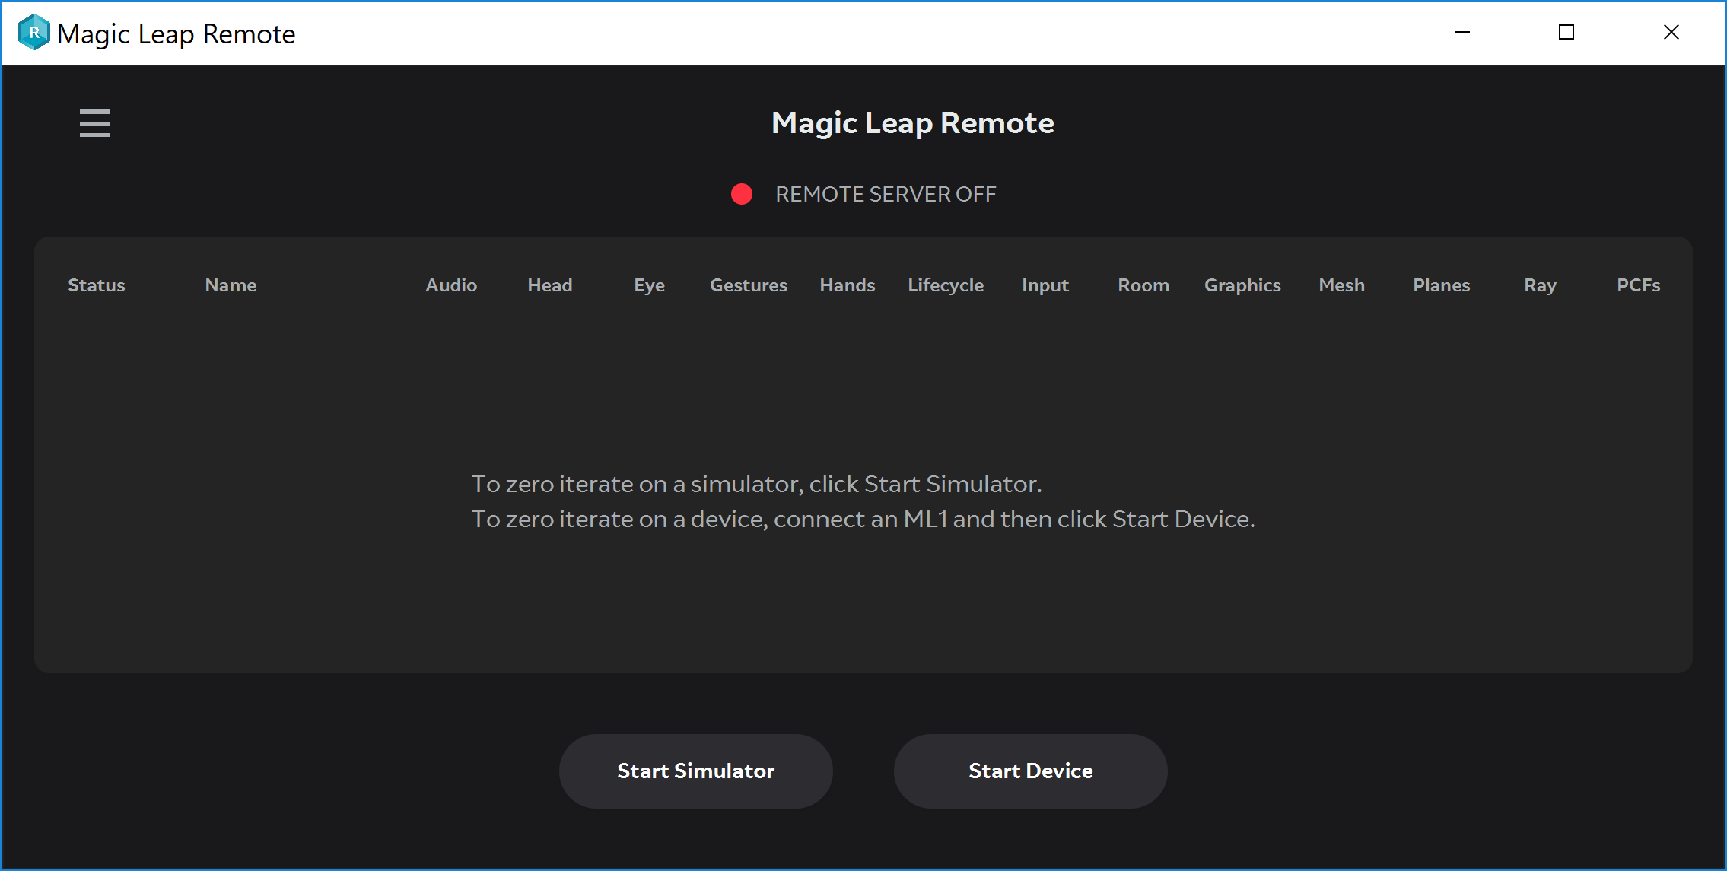

Slide 13
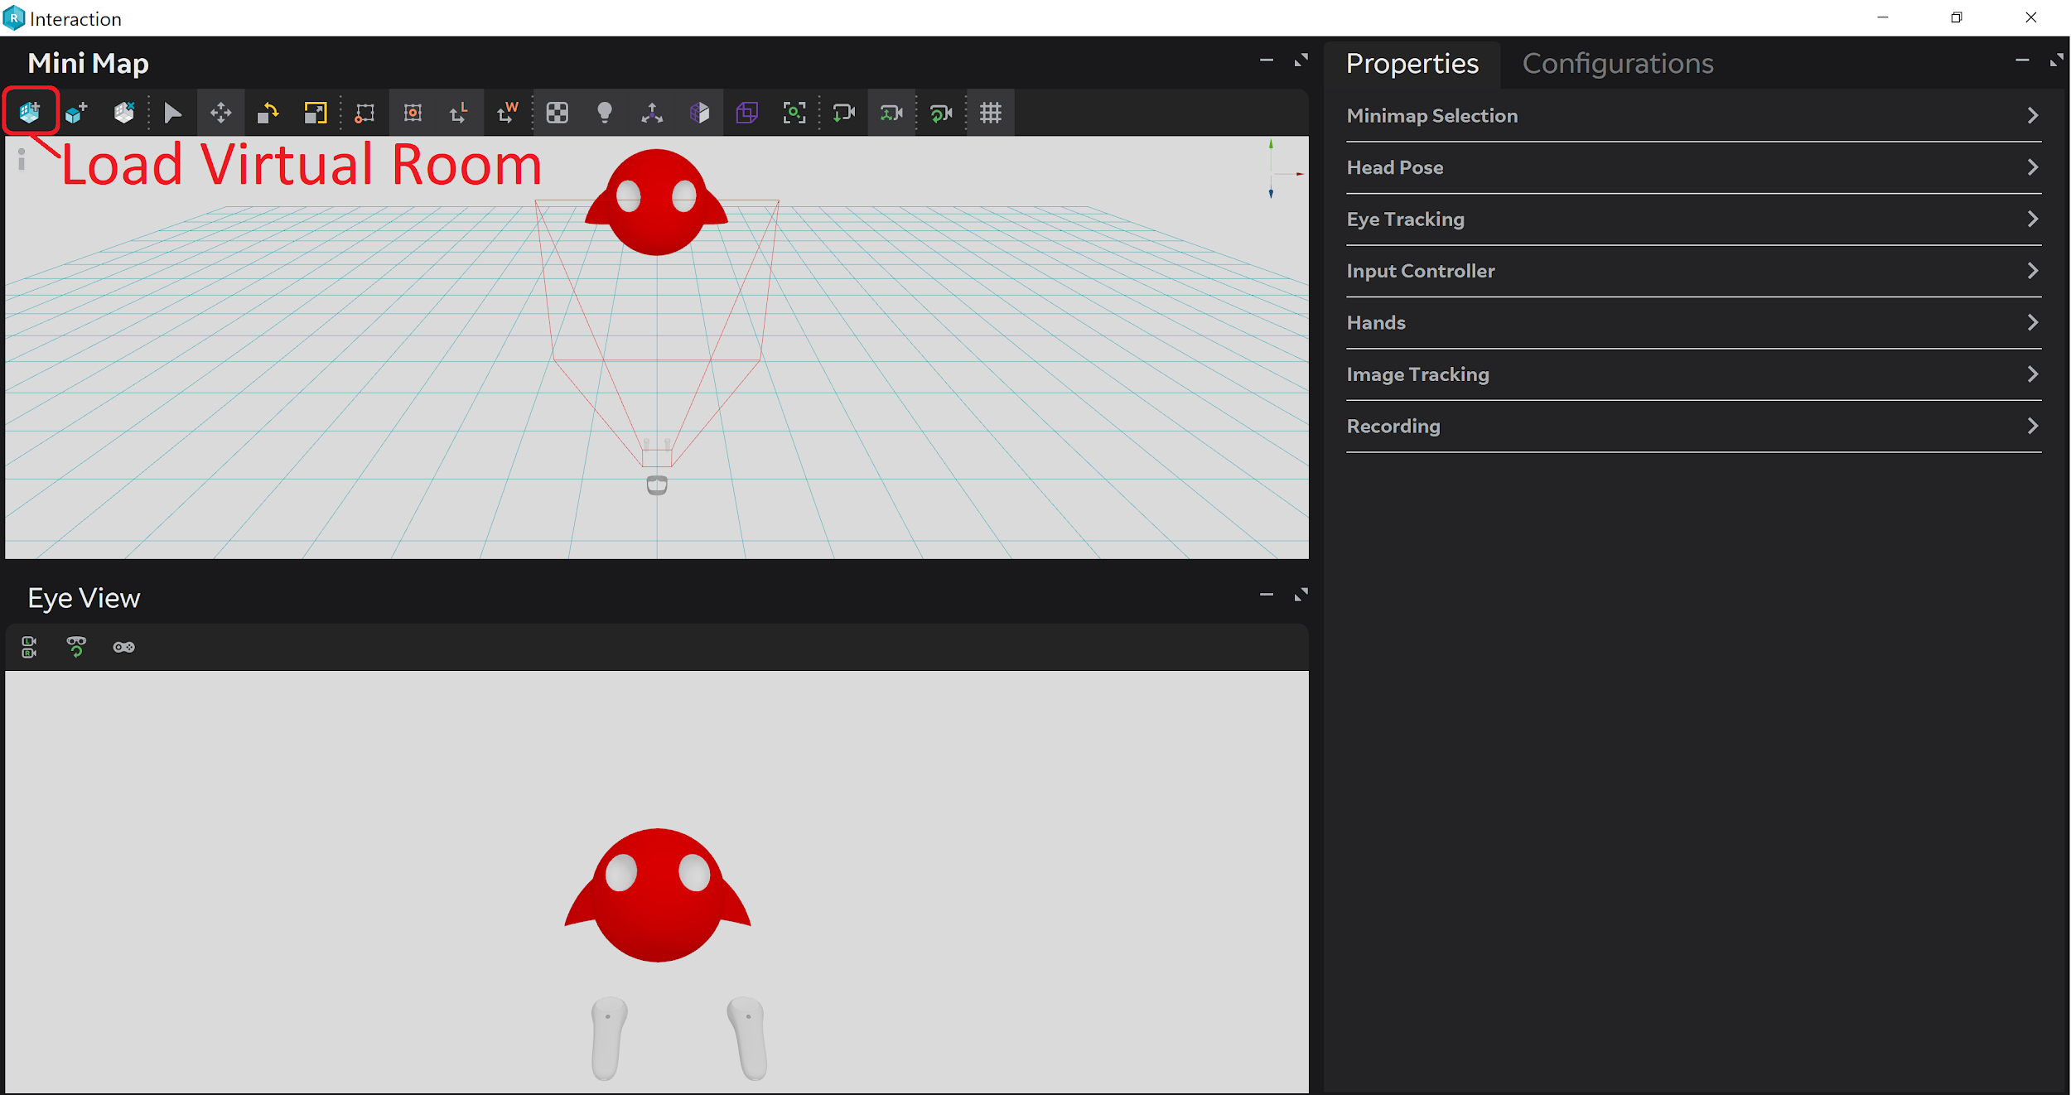
Notes:
The first time you will need to load a virtual room. Select the first icon at the top-left of the Mini Map window.
<Lumin SDK> > MagicLeap > mlsdk > v#.##.# > VirtualDevice > data > VirtualRooms > ExampleRooms
Select the Lounge.room, and then click Open

Slide 14
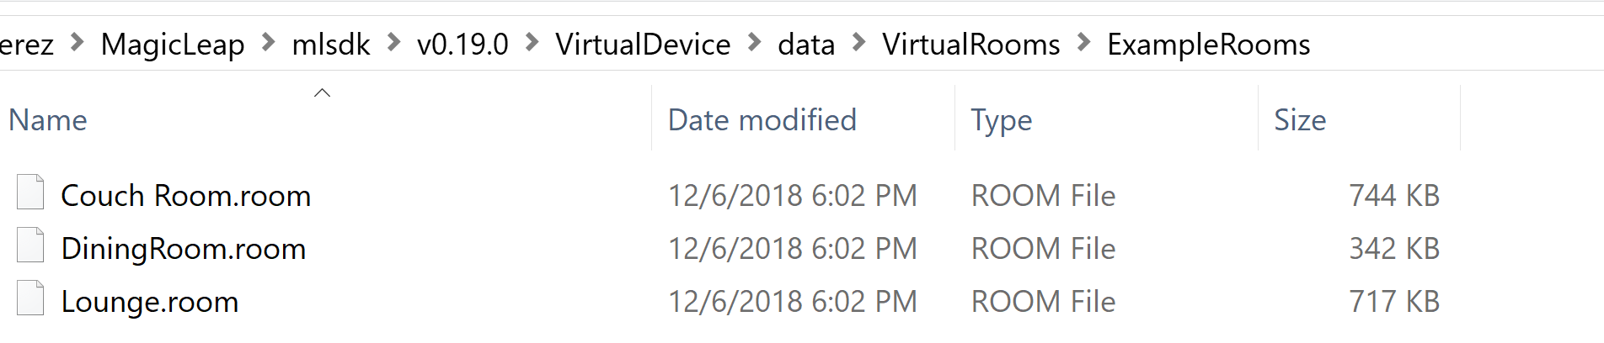
Load a Virtual Room
<Lumin SDK> > MagicLeap > mlsdk > v#.##.# > VirtualDevice > data > VirtualRooms > ExampleRooms
Notes:
https://creator.magicleap.com/learn/tutorials/magic-leap-remote-hello-cube-unity-r-edition

Slide 15
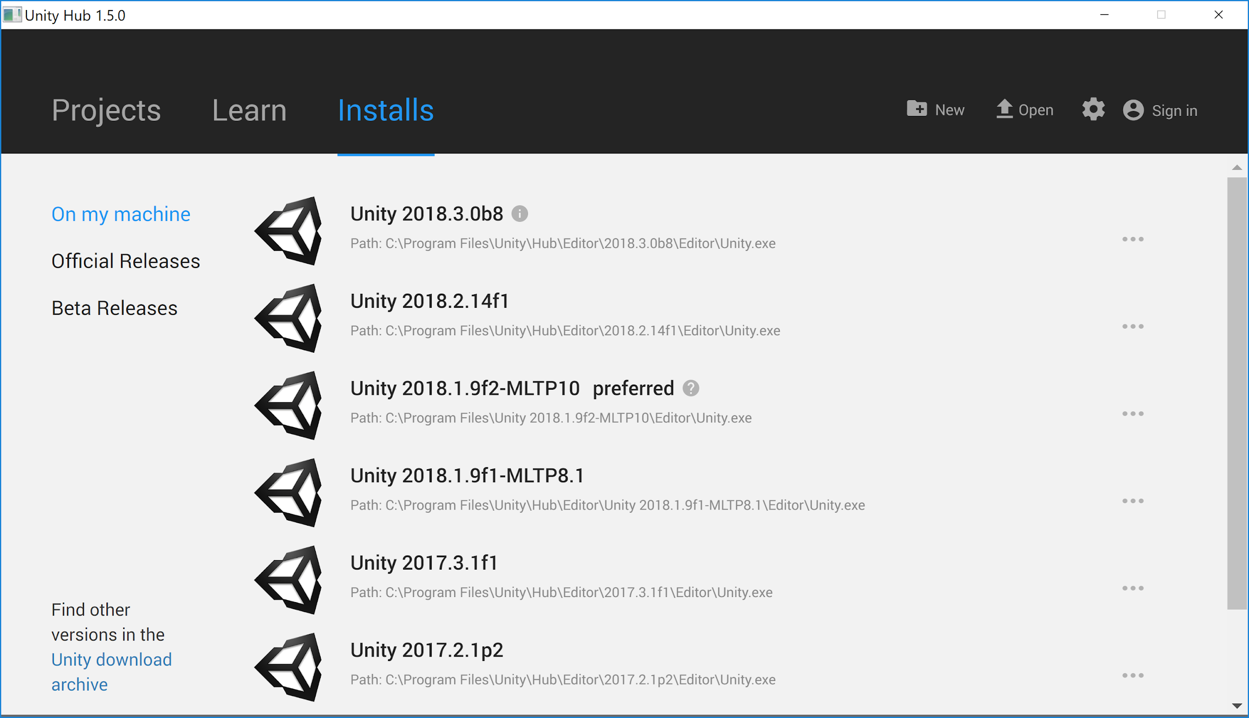
Notes:
Unity Hub

Slide 16
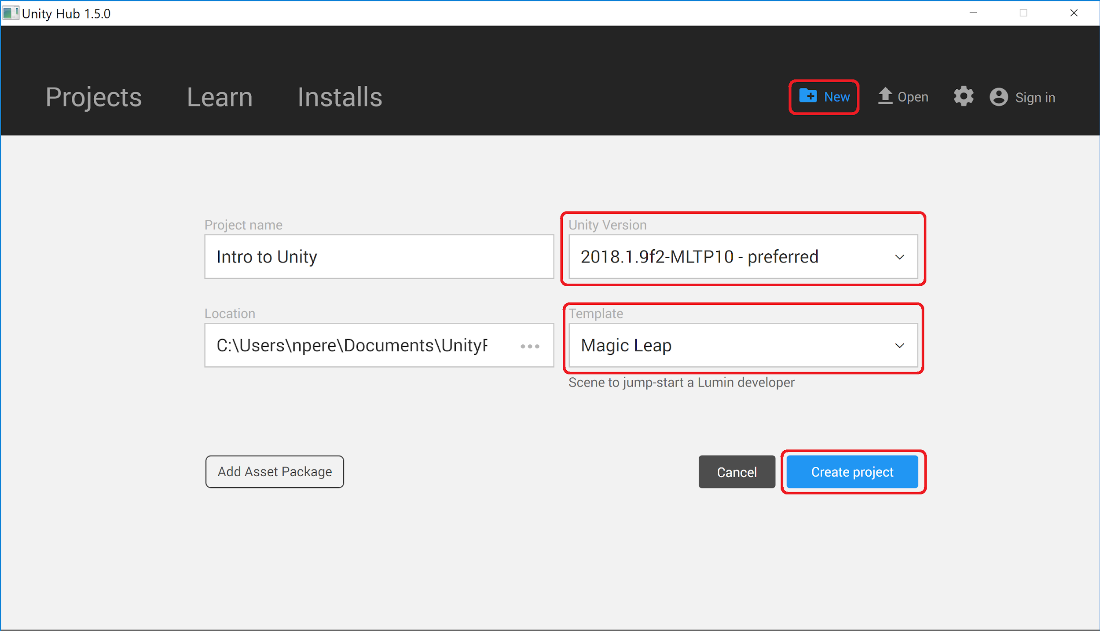
Notes:
For Magic Leap projects:
Create new project
- New Project
- MLTP Unity Version
- Magic Leap
- Rename project
- Create Project

Slide 17
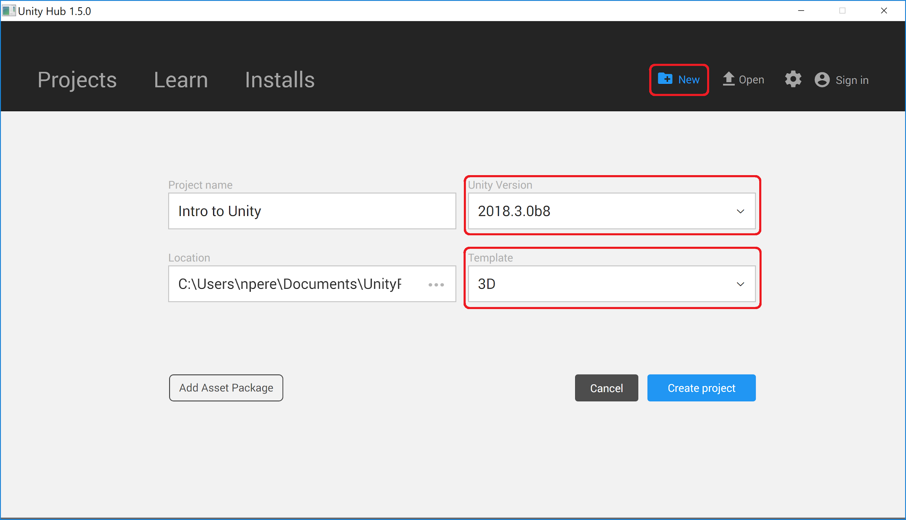
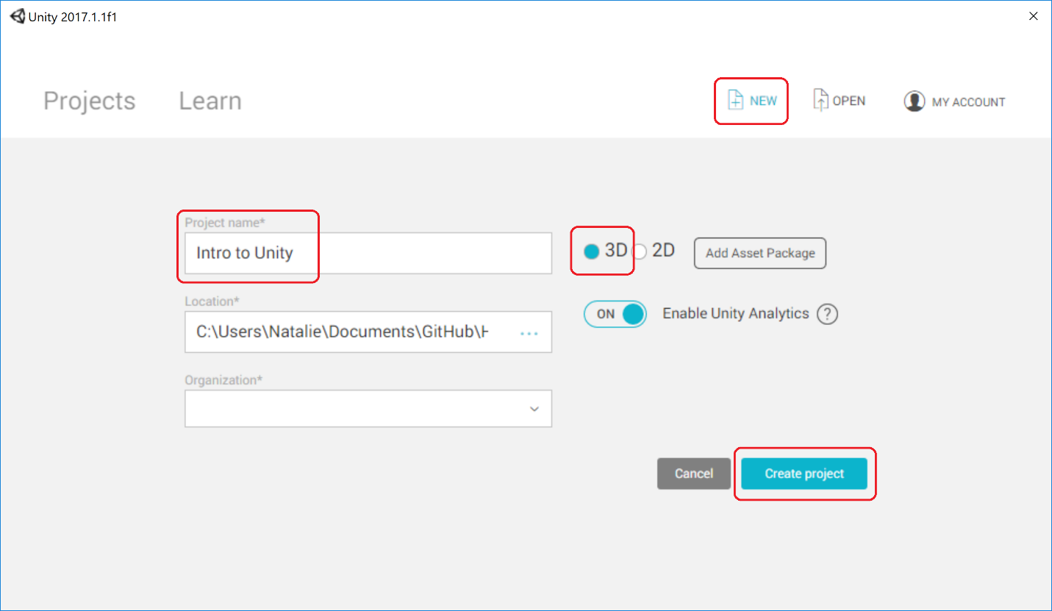
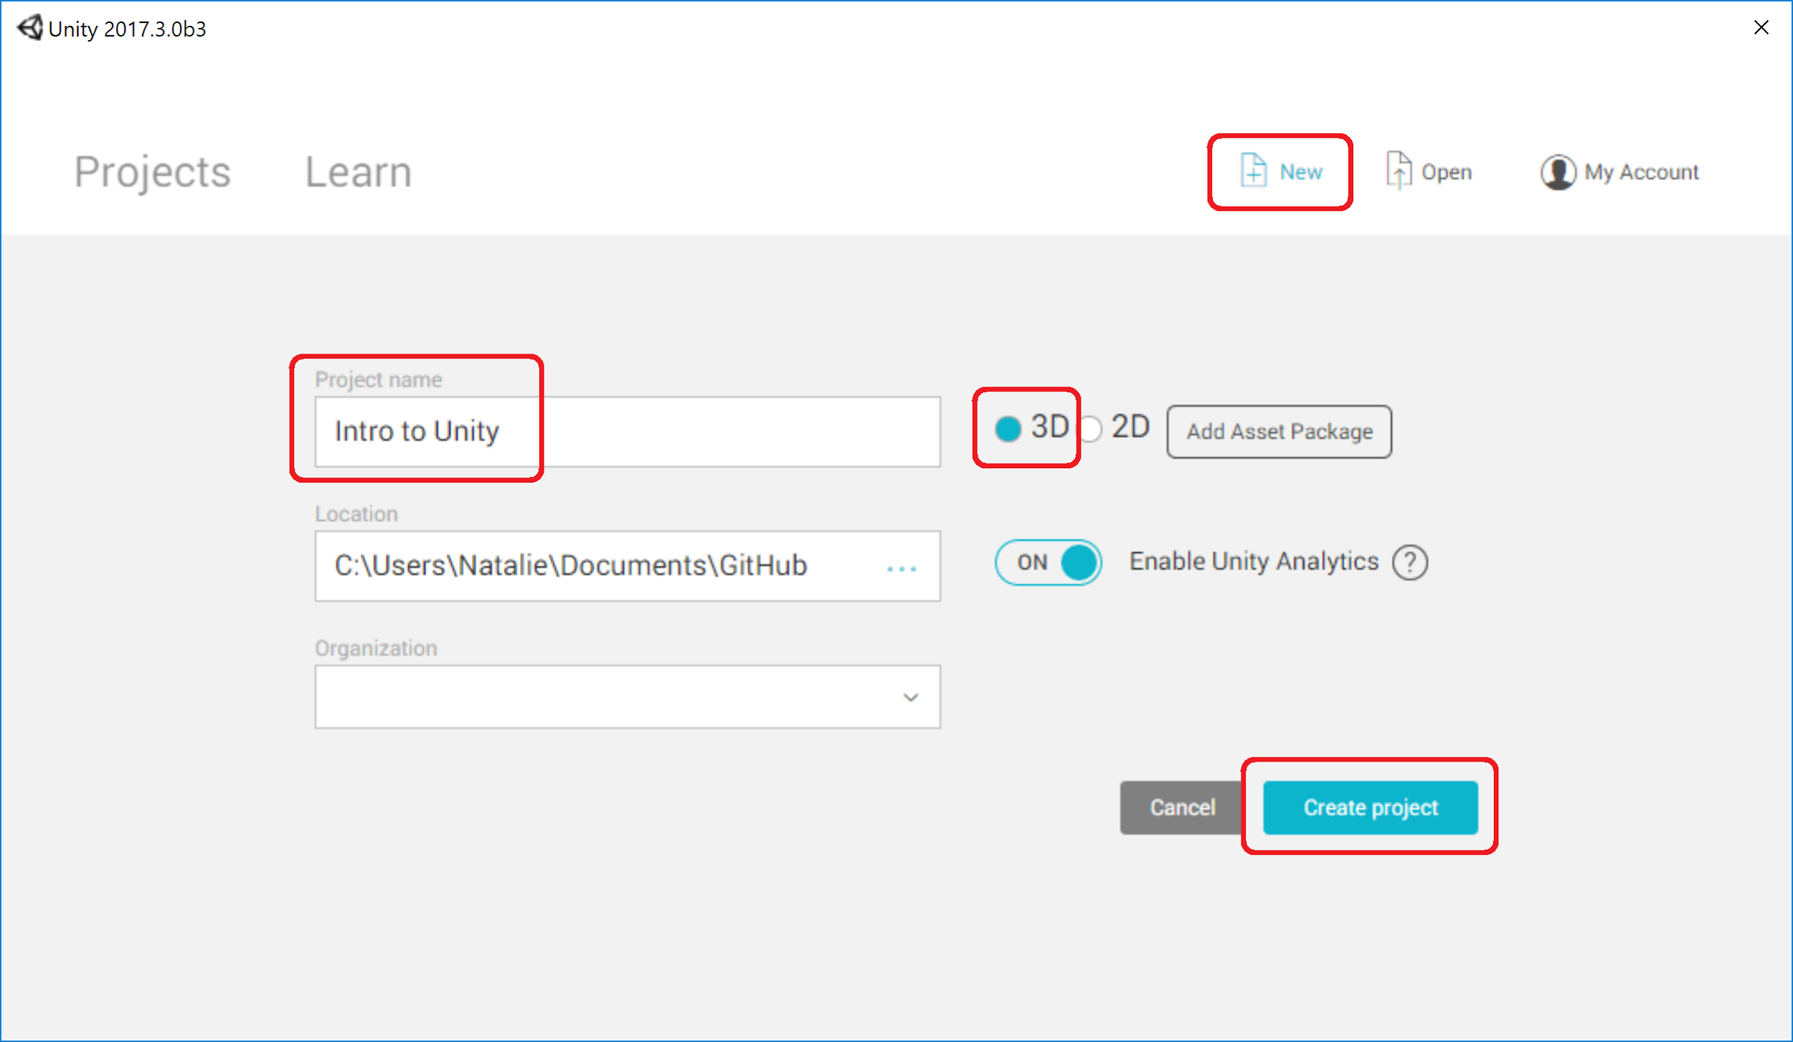
Notes:
For non-Magic Leap projects use 3D template and regular Unity Version:
Create new project
- New Project
- 3D
- Rename project
- Create Project

Slide 18
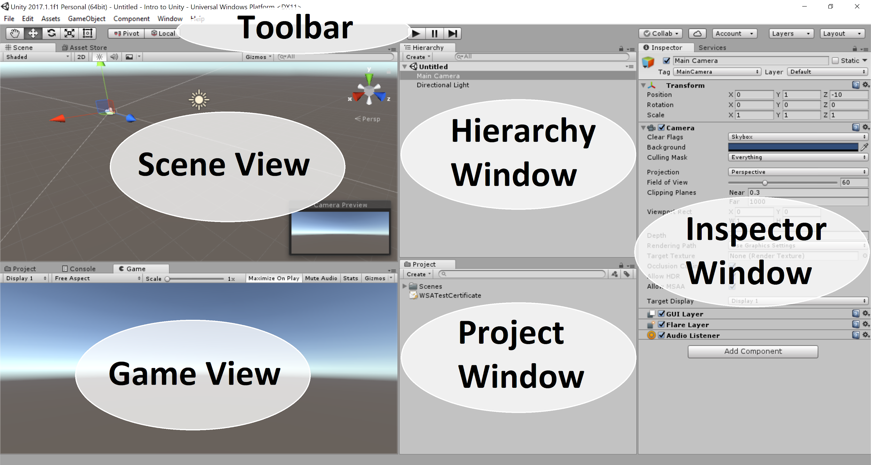
Notes:
Interface
The windows can be rearranged, grouped, detatched and docked.
The Scene View allows you to visually navigate and edit your scene. It’s where you visually build your game. To navigate in the scene view hold down the Alt key while holding down and moving your cursor
The Game View is rendered from the Camera(s) in your game. It is representative of your final, published game.
The Hierarchy Window is a text representation of every object in the scene. It reveals the structure of how objects are attached to one another.
The Project Window displays your library of assets that are available to use in your project.
The Inspector Window allows you to view and edit all the properties of the currently selected object. It changes depending on the object you have selected.
The Toolbar provides access to the most essential working features. On the left it contains the basic tools for manipulating the scene view and the objects within it. In the centre are the play, pause and step controls. The buttons to the right give you access to your Unity Cloud Services and your Unity Account, followed by a layer visibility menu, and finally the editor layout menu (which provides some alternate layouts for the editor windows, and allows you to save your own custom layouts). The toolbar is not a window and is the only part of the Unity interface that you can’t rearrange.

Slide 19
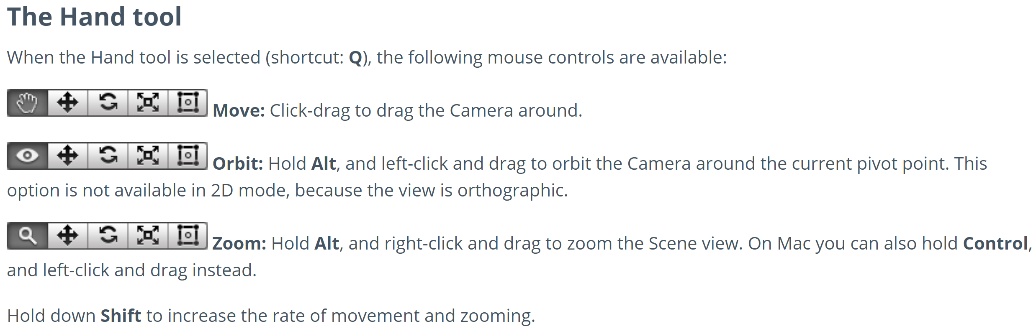
Navigating in the Scene View
Notes:
https://docs.unity3d.com/Manual/SceneViewNavigation.html
Flythrough mode
Use Flythrough mode to navigate the Scene view by flying around in first-person, similar to how you would navigate in many games.
Click and hold the right mouse button.
Move the view around using the mouse, the WASD keys to move left/right/forward/backward, and the Q and E keys to move up and down.
Hold down Shift to move faster.
Flythrough mode is designed for Perspective Mode. In Orthographic Mode, holding down the right mouse button and moving the mouse orbits the Camera instead.
Note that Flythrough mode is not available in 2D mode. Instead, holding the right mouse button down while moving the mouse pans around the Scene view.
The Hand tool
When the Hand tool is selected (shortcut: Q), the following mouse controls are available:
Move: Click-drag to drag the Camera around.
Orbit: Hold Alt, and left-click and drag to orbit the Camera around the current pivot point. This option is not available in 2D mode, because the view is orthographic.
Zoom: Hold Alt, and right-click and drag to zoom the Scene view. On Mac you can also hold Control, and left-click and drag instead.
Hold down Shift to increase the rate of movement and zooming.

Slide 20
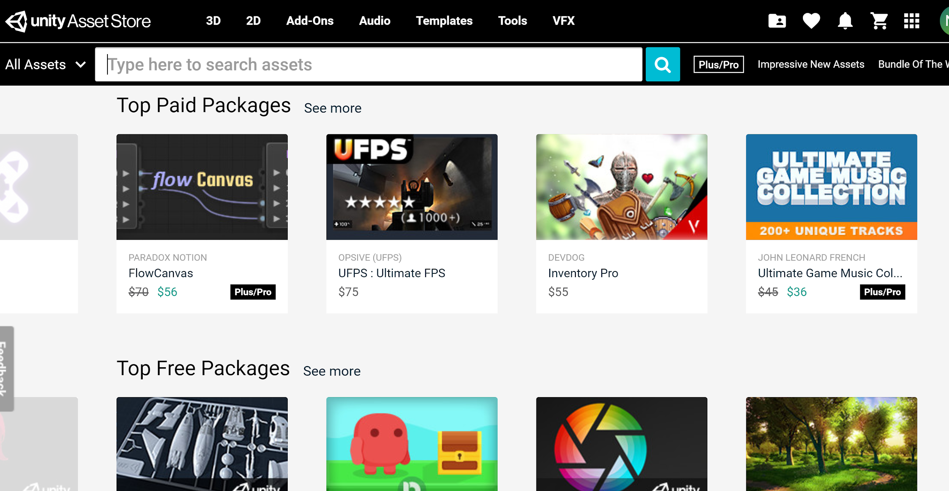
Notes:
The Unity Asset Store is home to a growing library of free and commercial Assets created both by Unity Technologies and also members of the community. A wide variety of Assets are available, covering everything from Textures, Models and animations to whole Project examples, tutorials and Editor extensions. You can access the Assets from a simple interface built into the Unity Editor which allows you to download and import Assets directly into your Project. Unity users can become publishers on Asset Store, and sell the content they have created. To find out more, see Asset Store information on Asset Store Publishing.

Slide 21
Camera
Properties
Camera’s position should be (X: 0, Y: 0, Z: 0)
For AR/MR:
Set Clear Flags dropdown set to Solid Color
Set Background to the color Black: RGB (0,0,0)
For VR:
Keep Clear Flags dropdown set to Skybox
Notes:
Setting up Camera
- Create a new scene by going to File > New Scene
- Select the Main Camera in Hierarchy Window
- In the Inspector panel, change the Position (X: 0, Y: 0, Z: 0)
- For AR/MR:
- Set the Clear Flags dropdown set to Solid Color
- Set the Background color to black (which is transparent in AR/MR)
- For VR:
- Keep Clear Flags set to Skybox
- Keep the Near Clipping Planes field to the default 0.3
- File > Save Scene As
- Name the scene Main and save it in a new subfolder called Scenes (this is a new subfolder you create inside the Assets folder)
A camera is an object that defines a view in scene space. The object’s position defines the viewpoint, while the forward (Z) and upward (Y) axes of the object define the view direction and the top of the screen, respectively.
The Camera component also defines the size and shape of the region that falls within the view. With these parameters set up, the camera can display what it currently “sees” to the screen. As the camera object moves and rotates, the displayed view will also move and rotate accordingly.
Clear Flags determines which parts of the screen will be cleared. Each Camera stores color and depth information when it renders its view. The portions of the screen that are not drawn in are empty, and will display the skybox by default.
Skyboxes are a wrapper around your entire scene that shows what the world looks like beyond your geometry.
Clipping Planes is the distances from the camera to start and stop rendering.

Slide 22
Don’t forget to
save
File → Save Scene As
Create a subfolder called Scenes
Name the scene Main
Select Save
You will see this subfolder and scene in your Project Window
Notes:
A camera is an object that defines a view in scene space. The object’s position defines the viewpoint, while the forward (Z) and upward (Y) axes of the object define the view direction and the top of the screen, respectively.
The Camera component also defines the size and shape of the region that falls within the view. With these parameters set up, the camera can display what it currently “sees” to the screen. As the camera object moves and rotates, the displayed view will also move and rotate accordingly.
Clear Flags determines which parts of the screen will be cleared. Each Camera stores color and depth information when it renders its view. The portions of the screen that are not drawn in are empty, and will display the skybox by default.
Skyboxes are a wrapper around your entire scene that shows what the world looks like beyond your geometry.
Clipping Planes is the distances from the camera to start and stop rendering.

Slide 23
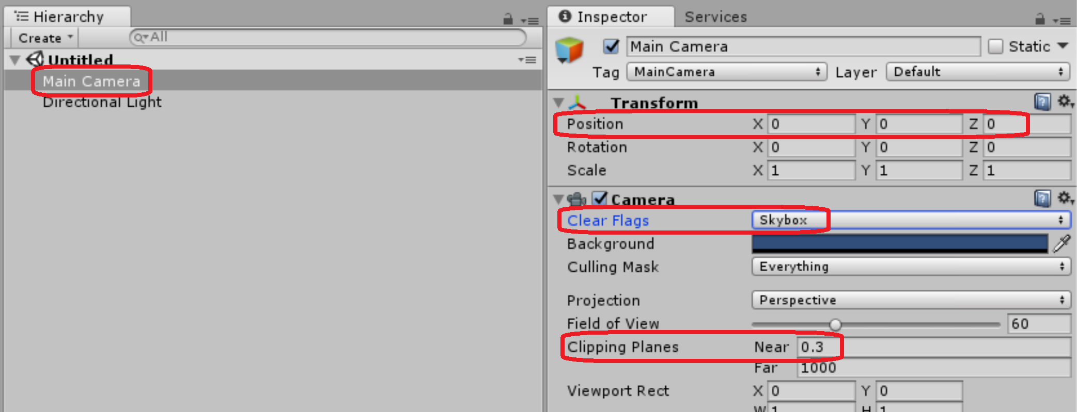
Camera Setup
Notes:
A camera is an object that defines a view in scene space. The object’s position defines the viewpoint, while the forward (Z) and upward (Y) axes of the object define the view direction and the top of the screen, respectively.
The Camera component also defines the size and shape of the region that falls within the view. With these parameters set up, the camera can display what it currently “sees” to the screen. As the camera object moves and rotates, the displayed view will also move and rotate accordingly.
Clear Flags determines which parts of the screen will be cleared. Each Camera stores color and depth information when it renders its view. The portions of the screen that are not drawn in are empty, and will display the skybox by default.
Skyboxes are a wrapper around your entire scene that shows what the world looks like beyond your geometry.
Clipping Planes is the distances from the camera to start and stop rendering.

Slide 24
Build Settings for Magic Leap
File → Build Settings...
Select the Lumin OS Platform
Set the Lumin SDK Location path. For example, C:\Users\<username>\MagicLeap\mlsdk\<version>
Check Sign Package
Add Open Scenes
Select Switch Platform
Open Player Settings...
Notes:
You must sign all packages built for the device with a Magic Leap developer certificate. There are two different certificate types: develop and submission. Develop certificates are used to sign multiple apps during development. Submission certificates are generated for each app you submit to the Magic Leap World store. You must store the .cert and .priv files in the same directory.
For Windows Mixed Reality (you will be in the regular Unity version so you won’t even see LuminOS as an option):
Select the Universal Windows Platform and leave Target Device at Any Device. For HoloLens, change it to HoloLens

Slide 25
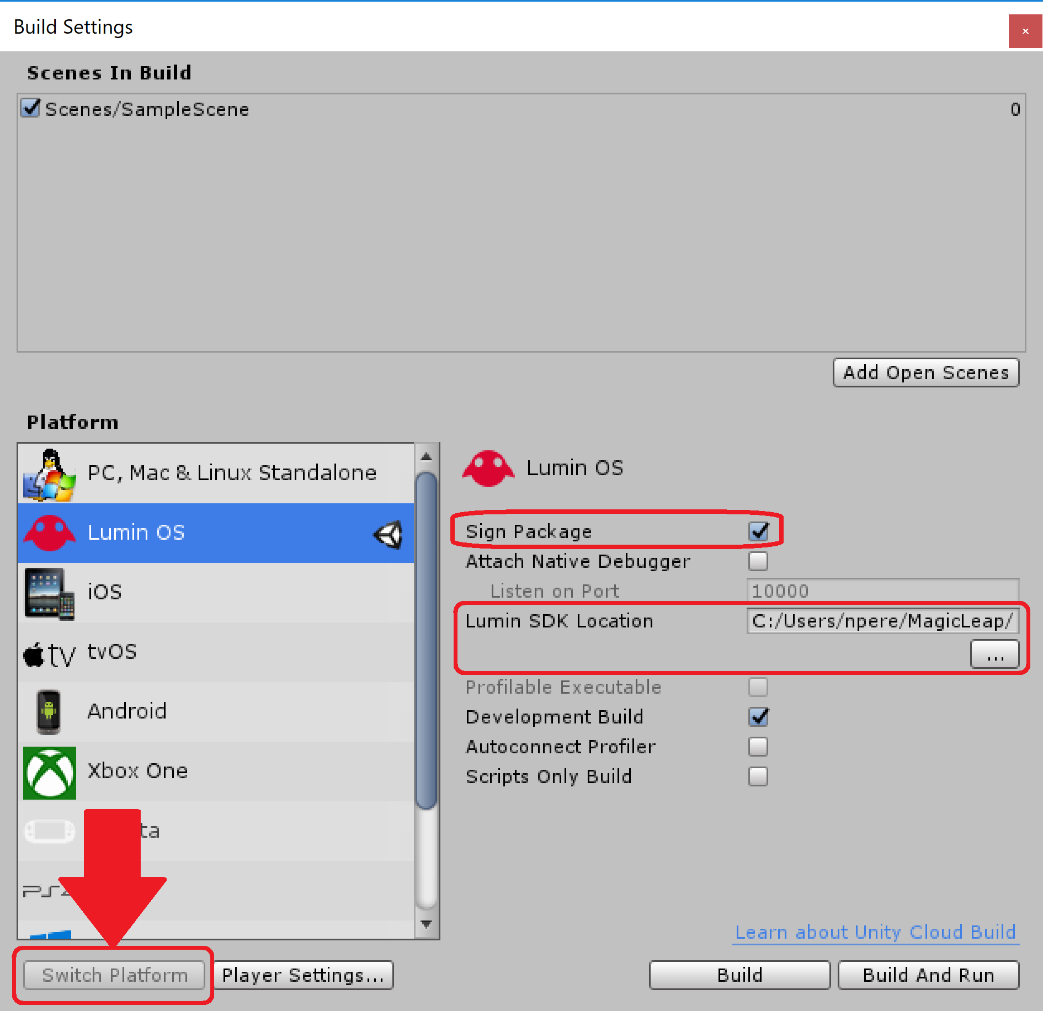
Magic
Leap

Slide 26
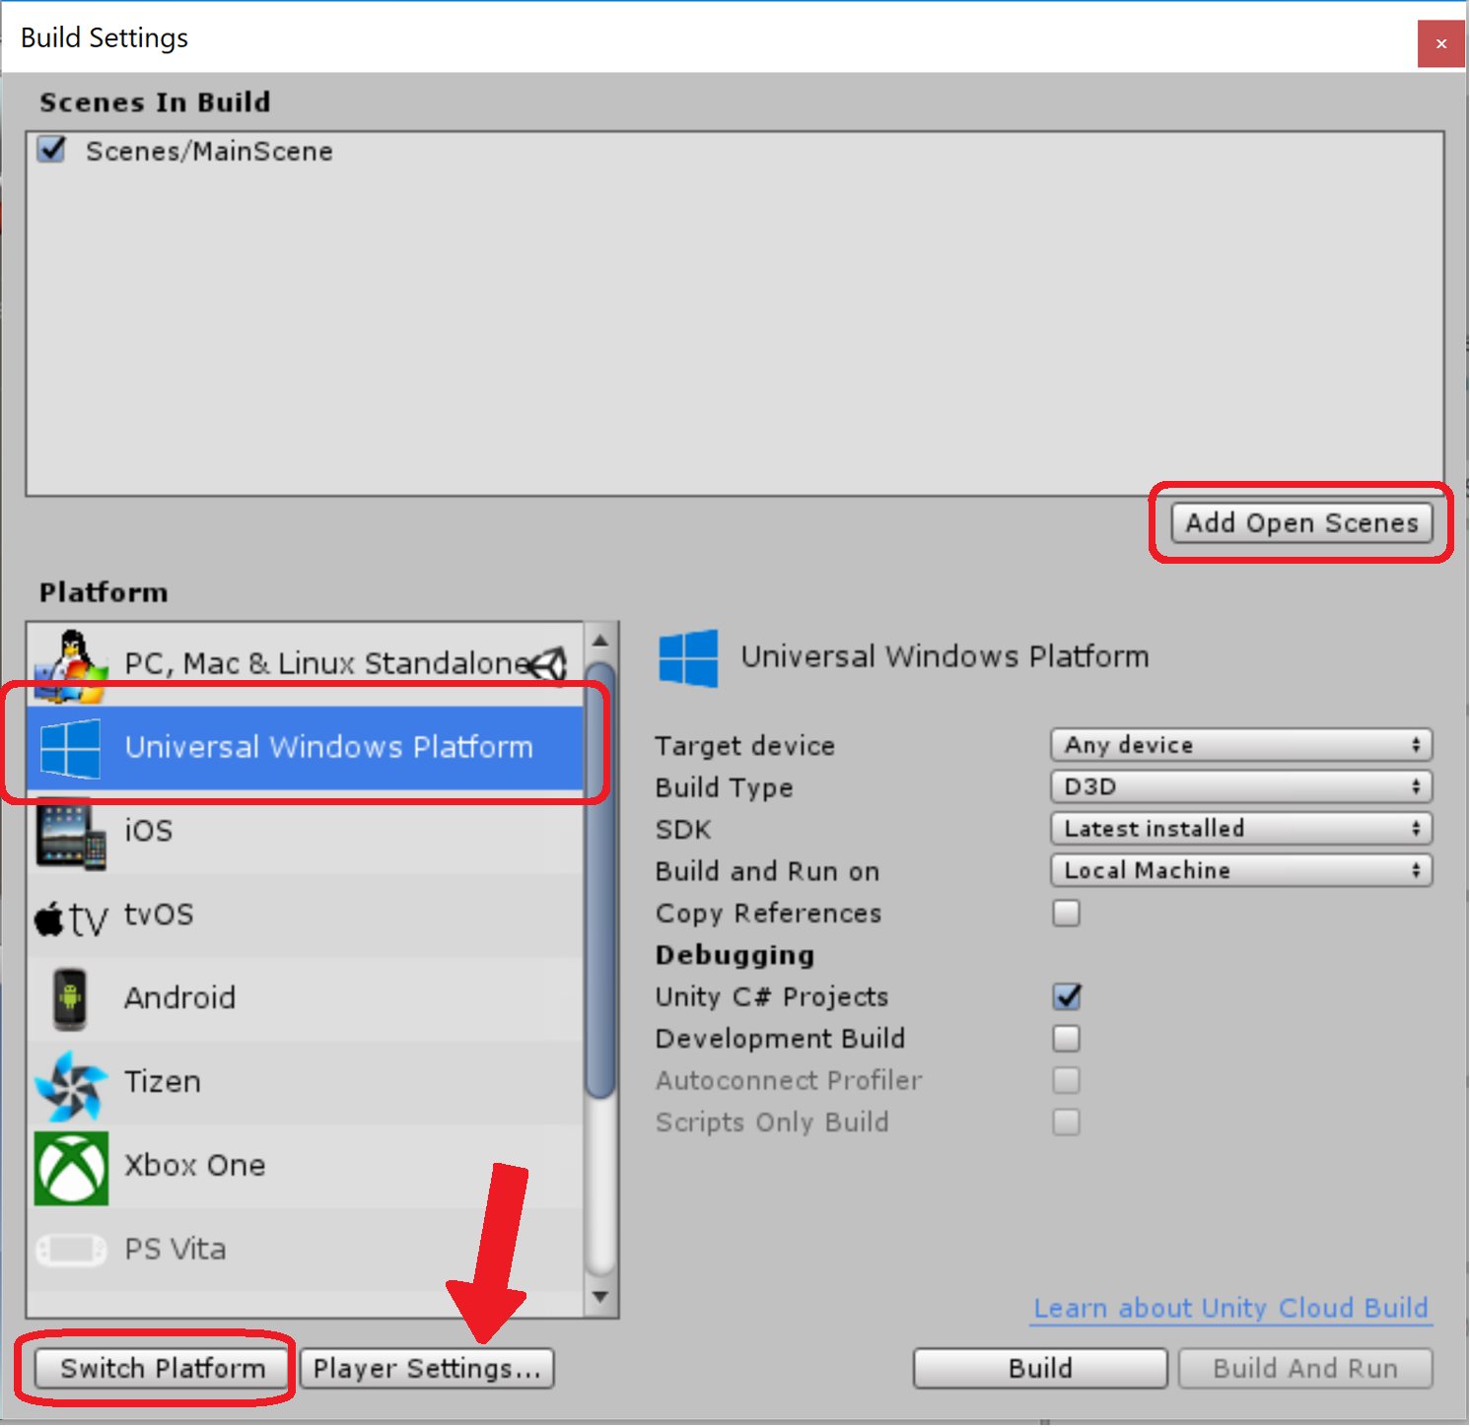
Windows
Mixed
Reality
&
HoloLens
Notes:
For WMR leave Target Device to Any device.
For HoloLens set Target Device to HoloLens
Build Settings
In order to debug scripts, check the “Unity C# project” box. This will create Assembly-CSharp-* projects compatible with Universal Windows Apps. Note: if previously Unity C# projects was unchecked, build to empty folder or delete .sln and .csproj, because Unity needs to add references to those files, but if they’ll be present - Unity won’t overwrite them
Scripting backend is a framework that powers scripting in Unity. Unity supports three different scripting backends depending on the target platform: Mono, .NET and IL2CPP. Universal Windows Platform, however, supports only two: .NET and IL2CPP. You can switch between selected scripting backend in player settings.
IL2CPP is a fully-supported scripting back end that can be used as an alternative to .NET when building projects for Universal Windows Platform. When building a project using IL2CPP, Unity converts IL code from scripts and assemblies to C++ before creating a native binary. Refer to the Unity Manual page on IL2CPP for more information.
The .NET Scripting Backend is using Microsofts .NET to power scripting. Unlike other Unity platforms, Universal Windows Platform is not using .NET 3.5 Class Libraries profile, but rather a subset of .NET 4.5. This is due to Windows Store certification requirements. This means that the platform has some incompatibilities compared to other platforms, such as different plugin model and many missing types that are present in .NET 3.5 profile that Unity normally uses.

Slide 27
Player Settings
Alternate way to get to Player Settings:
Edit → Project Settings → Player
Click on the Magic Leap Icon
Expand the Publishing Setting group
Add in your Magic Leap developer certificate
You can generate a certificate through the Magic Leap Creator Portal

Slide 28
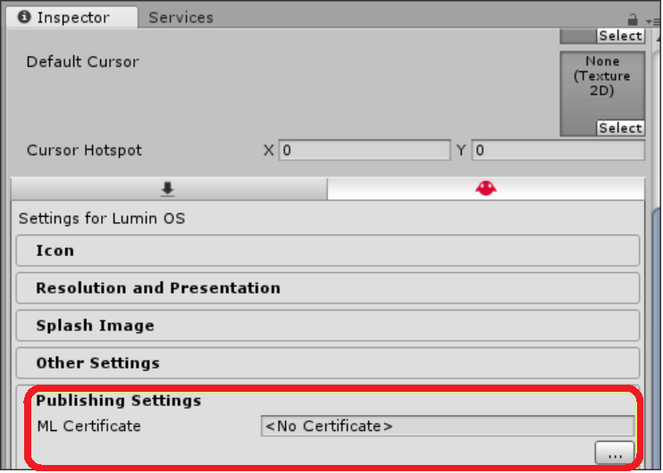
Notes:
Select Player Settings and under the Inspector tab in the Lumin OS settings section under Publishing Setting, browse to your Magic Leap developer certificate. Learn more about Developer Cert.
You must sign your applications and packages with a developer certificate generated from the Creator Portal to install or run them on Magic Leap One. You can use a single development certificate to sign all your applications under development.

Slide 29
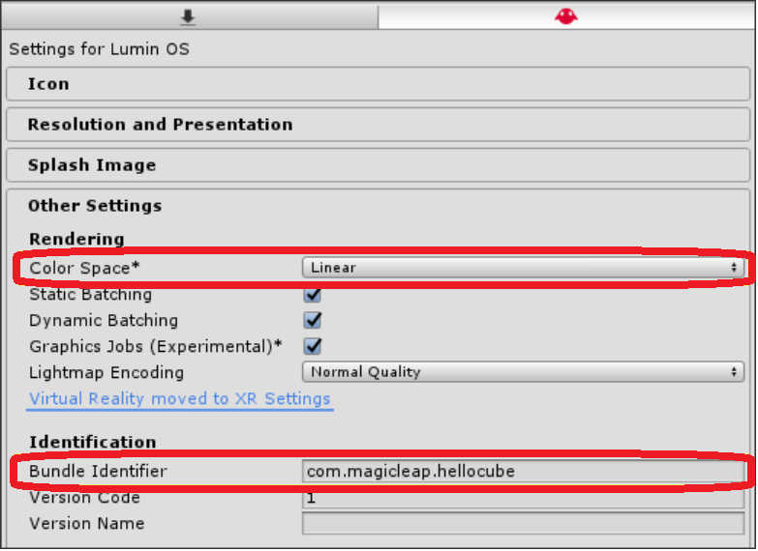
Notes:
Under Identification, enter your Bundle Identifier to identify your package. This name must be unique to submit your app to Magic Leap World. You are limited to 128 alphanumeric characters. We recommend using the following format: .com.company.application.

Slide 30
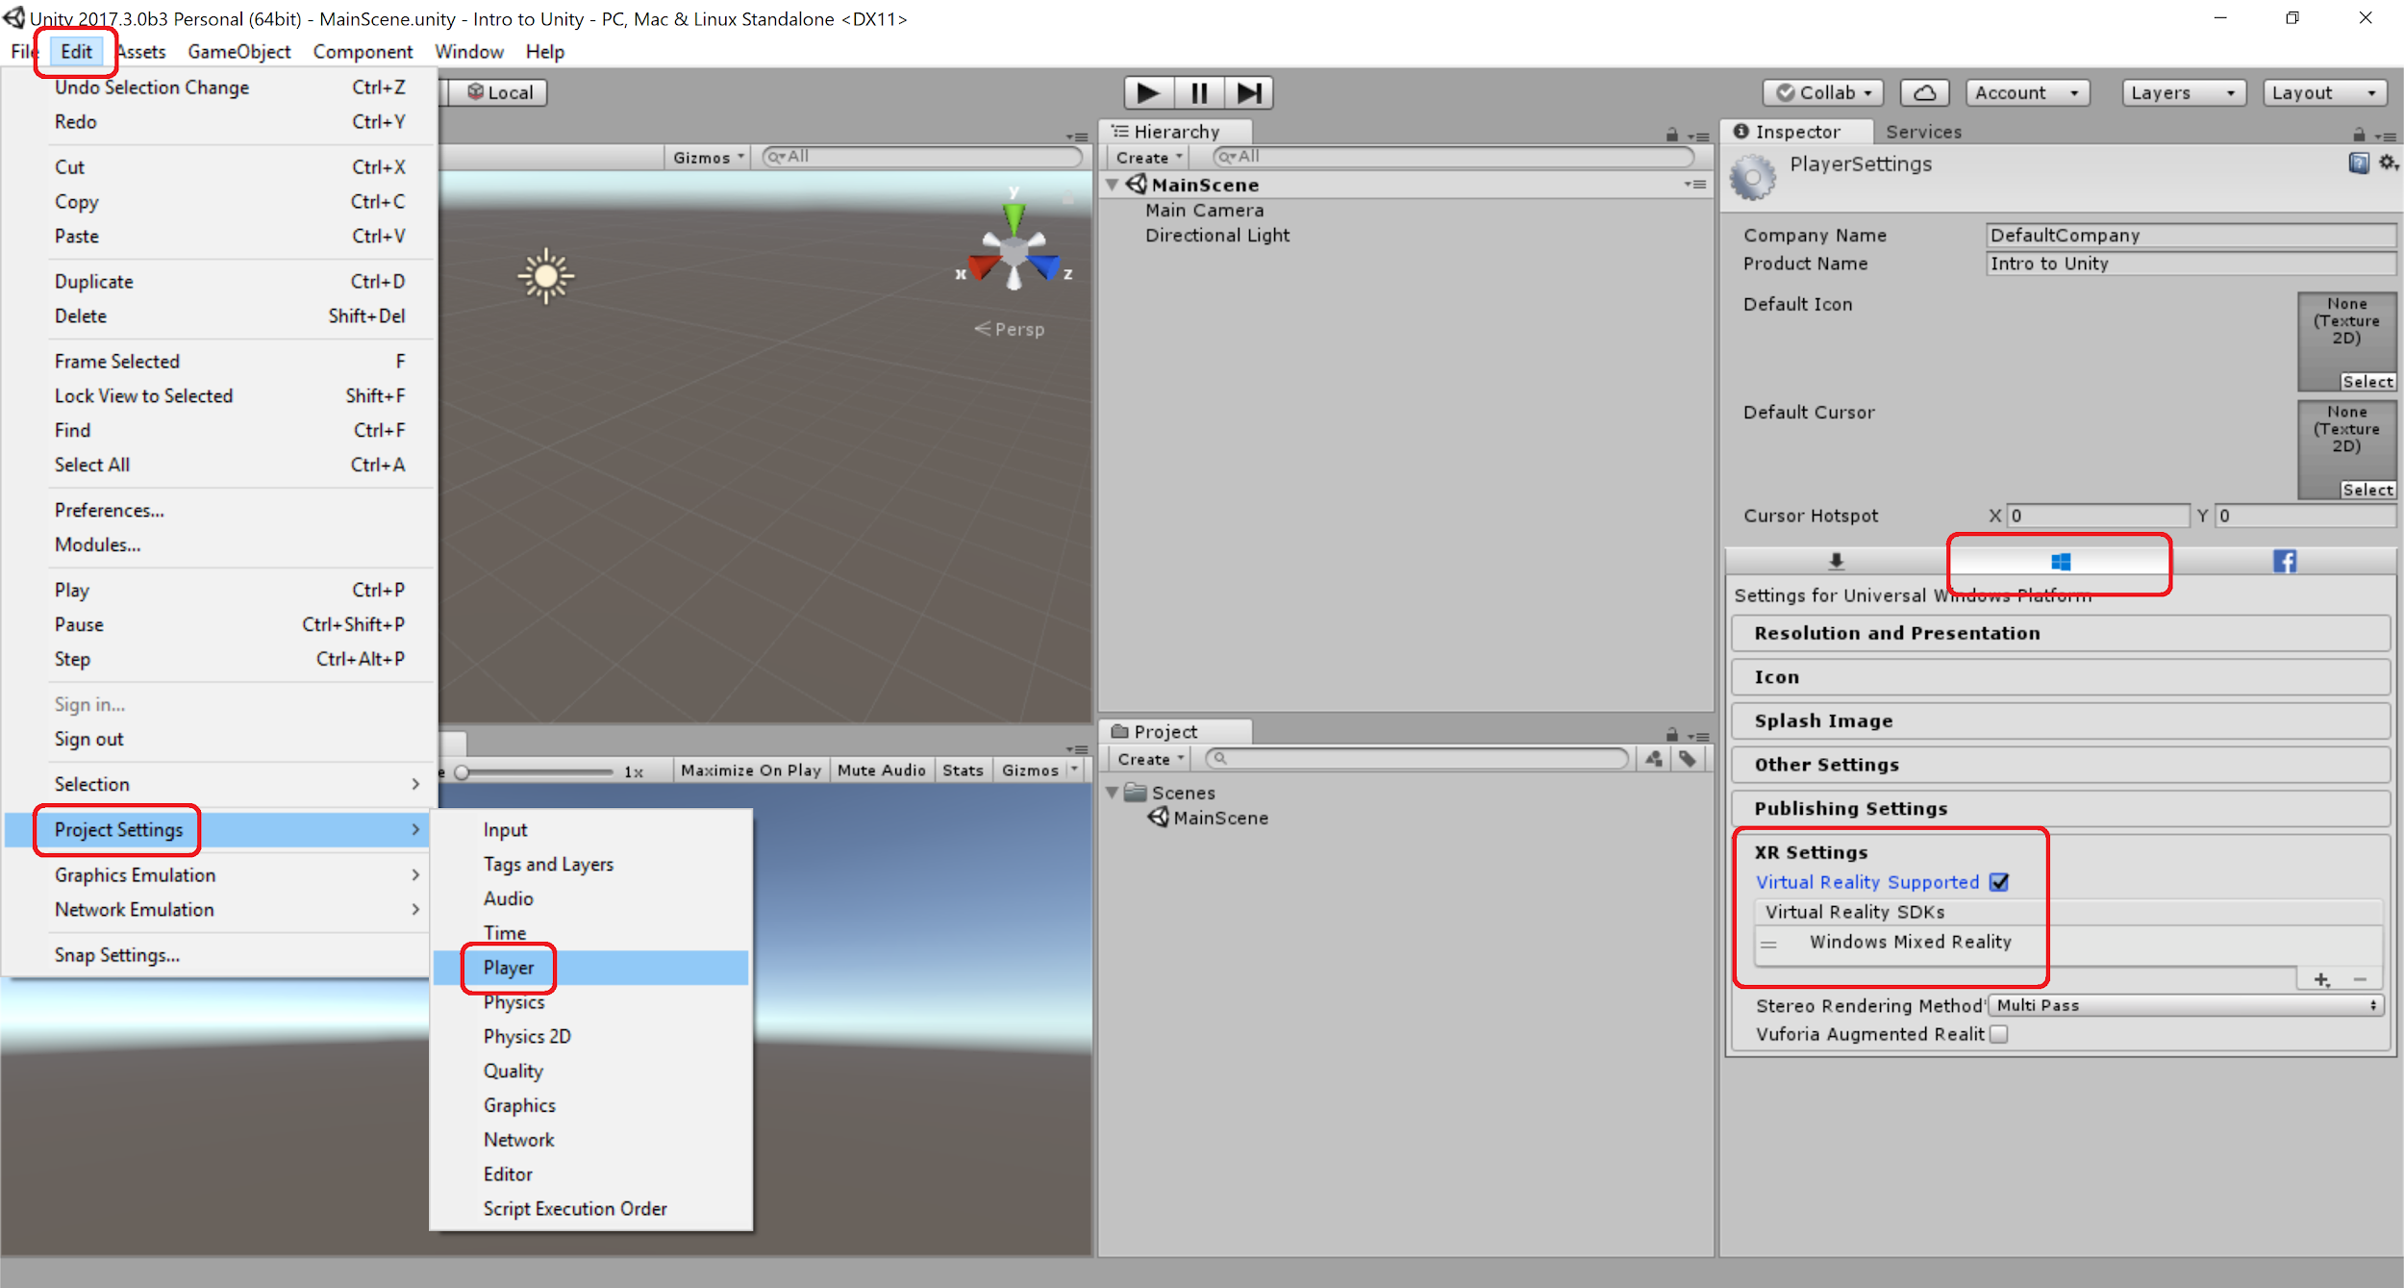
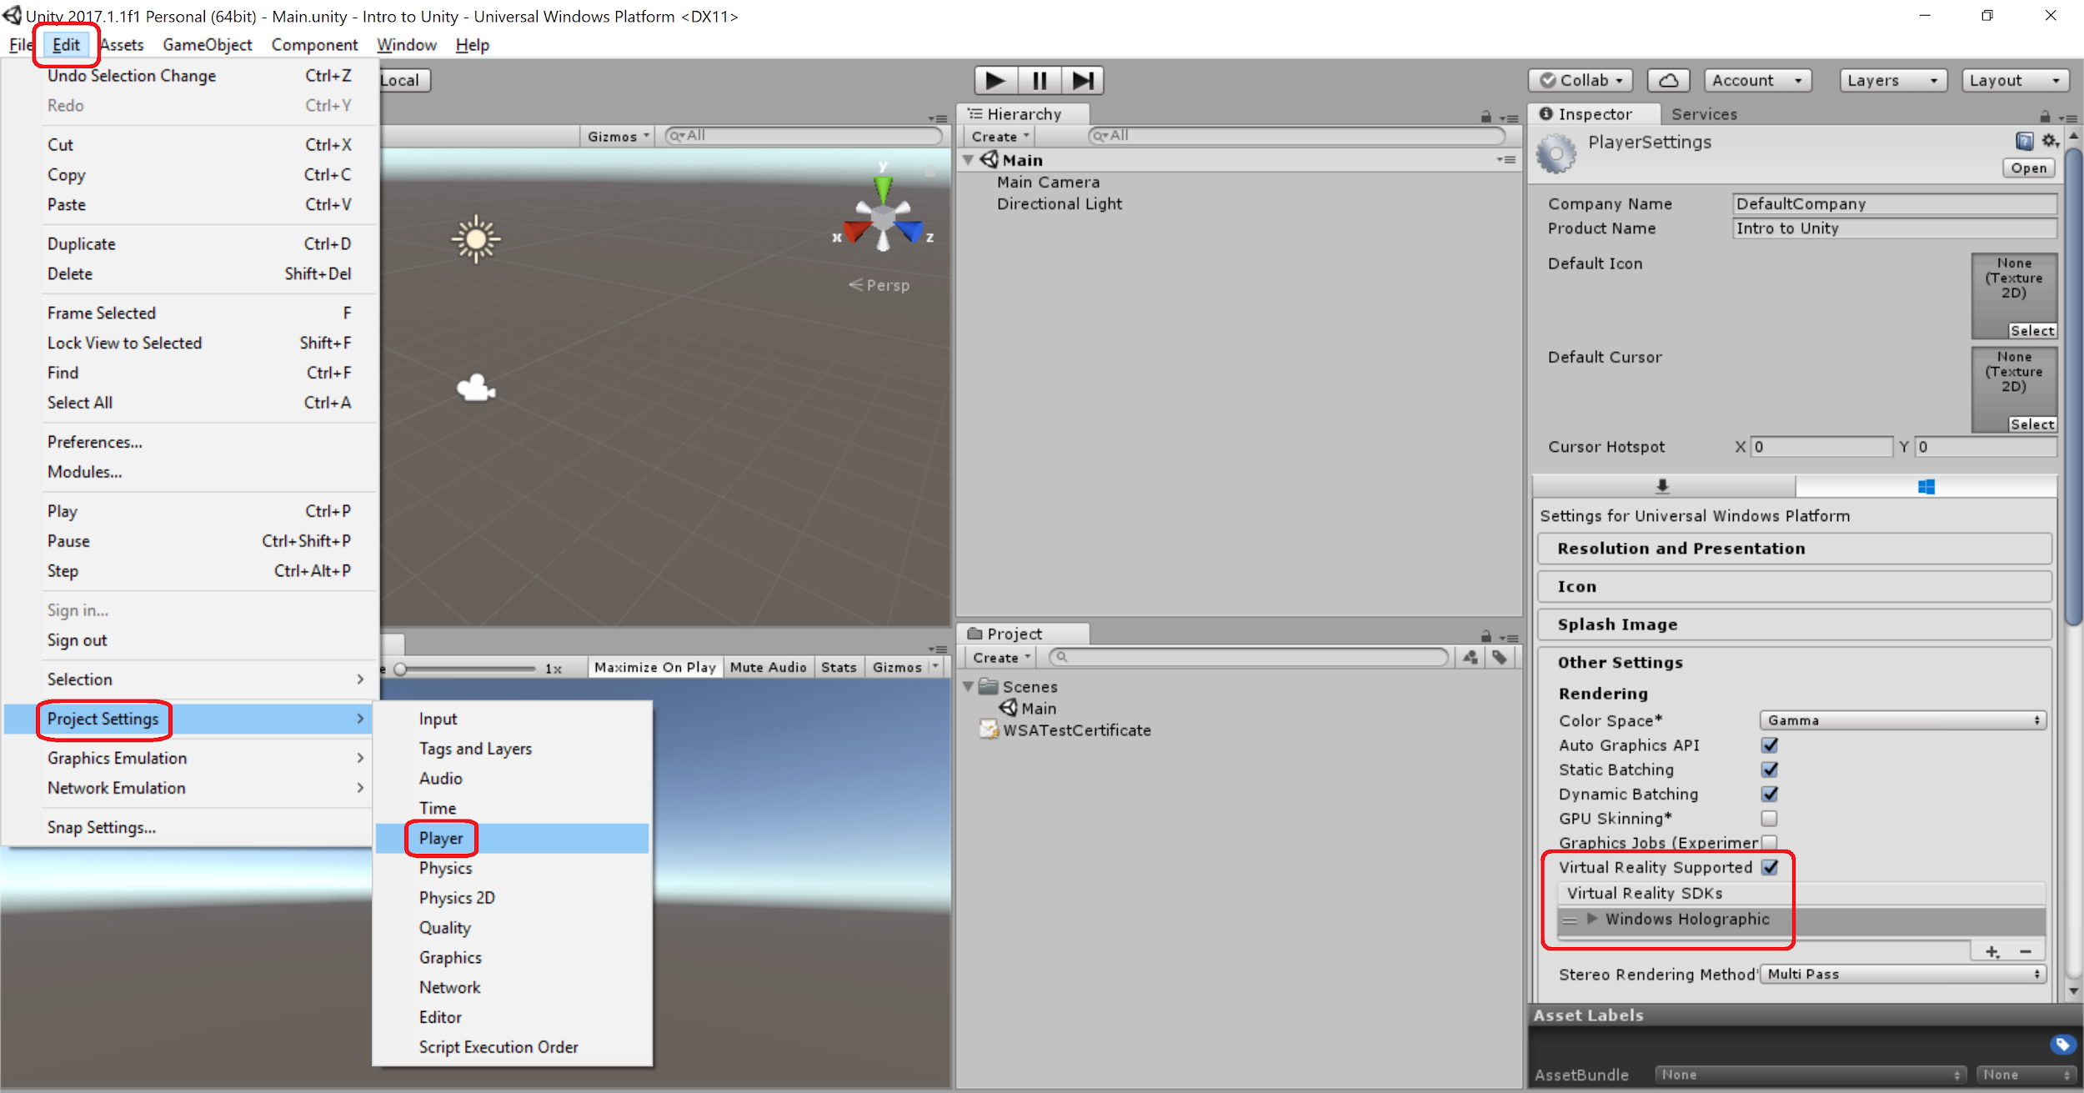
Notes:
Project Settings (For Windows Mixed Reality)
Enable Virtual Reality support on Unity targeting the Windows 10 SDK:
o Select Edit > Project Settings > Player
o In the Inspector panel click on the Windows Store tab
o In the XR Settings section, check the Virtual Reality Supported checkbox and confirm "Windows Mixed Reality" is listed as a supported SDK
Head tracking and the appropriate field of view (FOV) is automatically applied to the Camera if your device is head-mounted.

Slide 31
MixedRealityToolkit
Formerly known as the HoloToolkit
https://github.com/Microsoft/MixedRealityToolkit
Notes:
HOLOLENS & WMR: Adding the MR toolkit
https://github.com/Microsoft/MixedRealityToolkit
The Mixed Reality Toolkit for Unity includes many API's to accelerate the development of Mixed Reality projects
https://github.com/Microsoft/MixedRealityToolkit-Unity/blob/master/GettingStarted.md
After downloading/cloning the MRTK, then you need to import package into Unity project

Slide 32
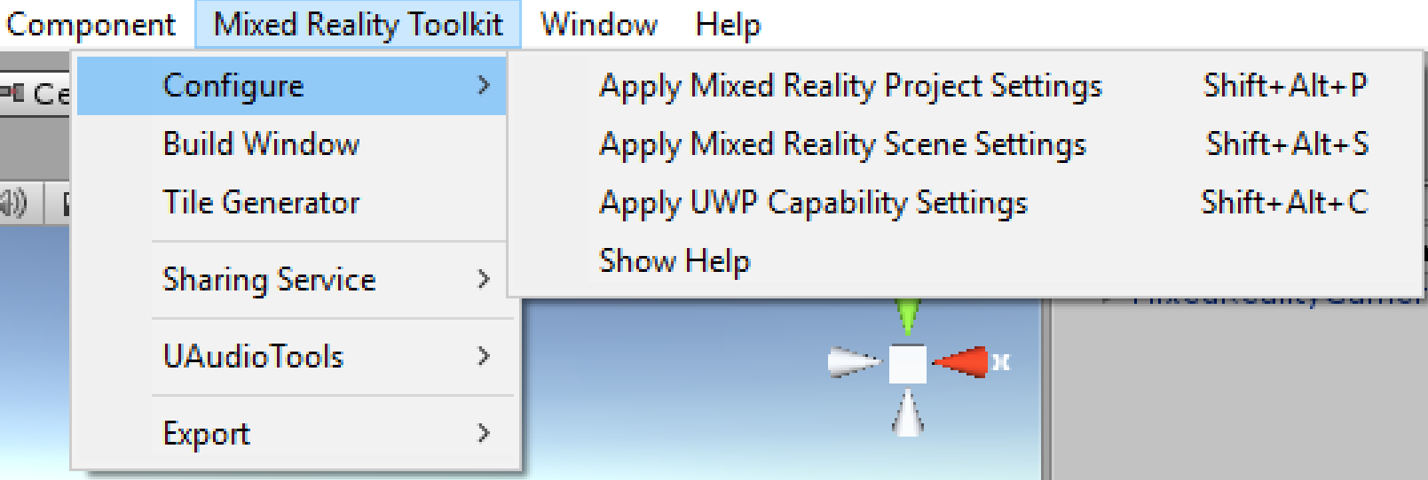
MixedRealityToolkit
Notes:
HOLOLENS AND WMR: Adding the MR toolkit
https://github.com/Microsoft/MixedRealityToolkit

Slide 33
Creating a Cube
In the Hierarchy panel, select the Create dropdown
3D Object > Cube
Select the Cube and in Inspector find the Transform component and change:
Position to (X: 0, Y: 0, Z: 2)
Rotation to (X: 45, Y: 45, Z: 45)
Scale to (X: 0.25, Y: 0.25, Z: 0.25)
Notes:
Creating a Cube
- In the Hierarchy panel, select the Create dropdown and choose 3D Object > Cube
- Select the Cube in the Hierarchy panel
- In the Inspector find the Transform component and change
o Position to (X: 0, Y: 0, Z: 2)
o Rotation to (X: 45, Y: 45, Z: 45)
o Scale to (X: 0.25, Y: 0.25, Z: 0.25)
- File > Save Scene
GameObjects are the fundamental objects in Unity that represent characters, props and scenery. They do not accomplish much in themselves but they act as containers for Components, which implement the real functionality.
A solid cube object has a Mesh Filter and Mesh Renderer component, to draw the surface of the cube, and a Box Collider component to represent the object’s solid volume in terms of physics.

Slide 34
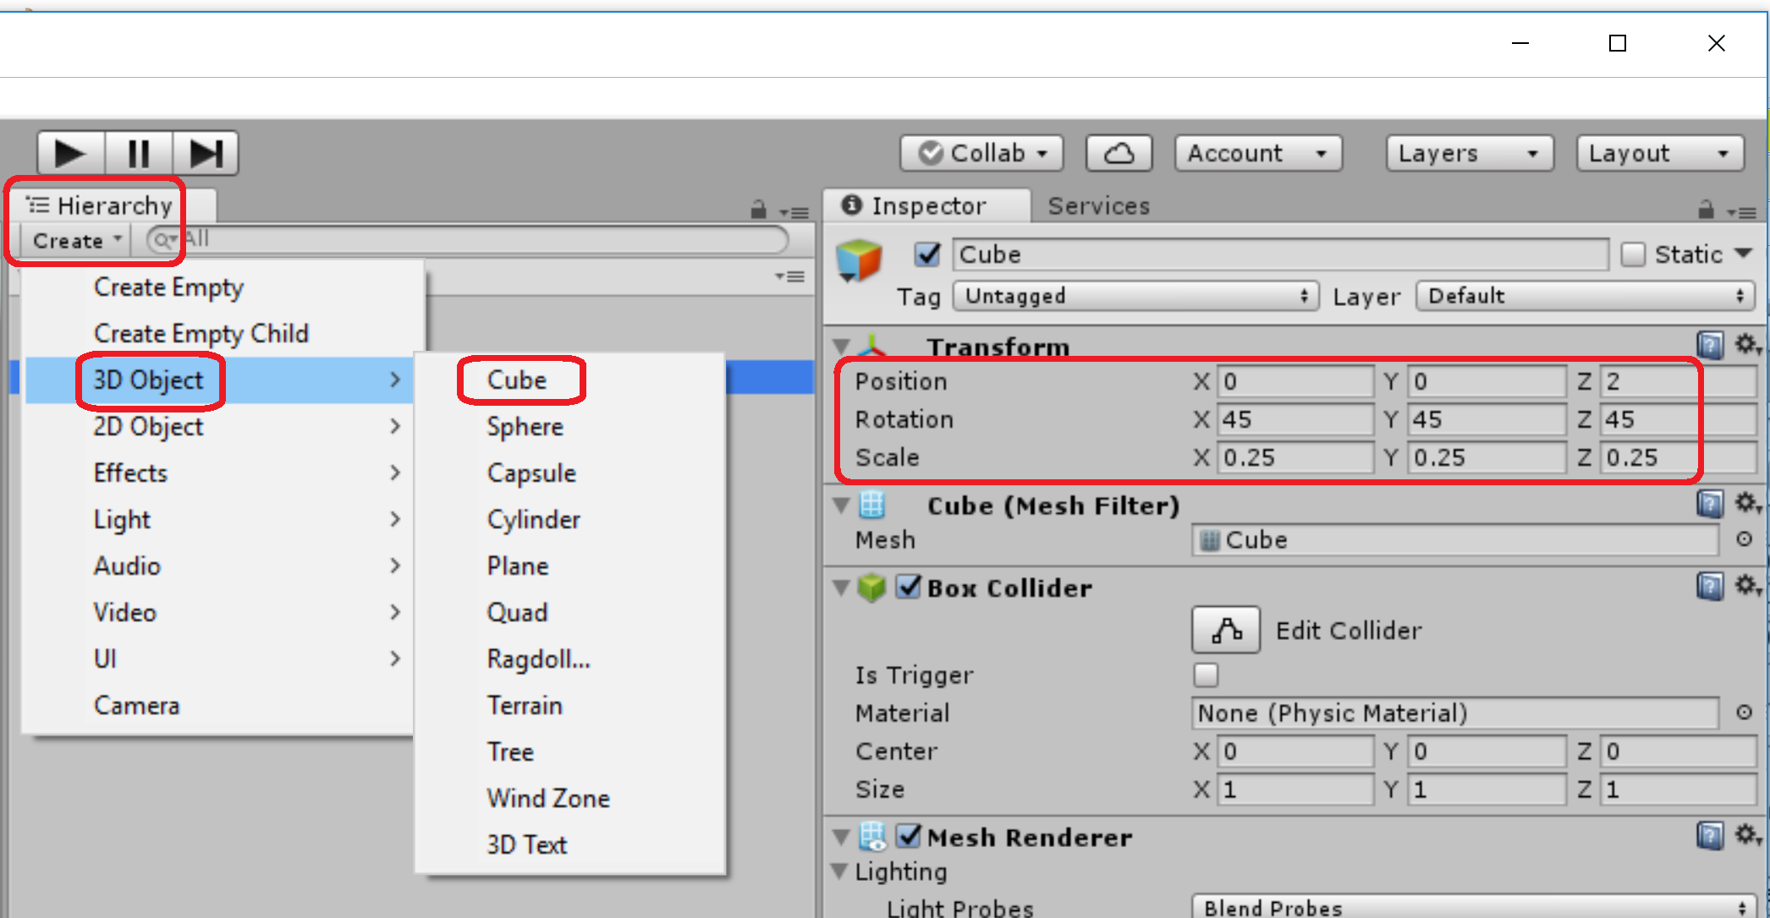
Notes:
Creating a Cube
- In the Hierarchy panel, select the Create dropdown and choose 3D Object > Cube
- Select the Cube in the Hierarchy panel
- In the Inspector find the Transform component and change
o Position to (X: 0, Y: 0, Z: 2)
o Rotation to (X: 45, Y: 45, Z: 45)
o Scale to (X: 0.25, Y: 0.25, Z: 0.25)
- File > Save Scene
GameObjects are the fundamental objects in Unity that represent characters, props and scenery. They do not accomplish much in themselves but they act as containers for Components, which implement the real functionality.
A solid cube object has a Mesh Filter and Mesh Renderer component, to draw the surface of the cube, and a Box Collider component to represent the object’s solid volume in terms of physics.

Slide 35
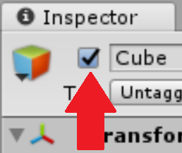
Deactivate and Reactivate Game Objects
Hide the Cube by unchecking the box in the Inspector window to the left of its name
This is the checkbox to activate or deactivate the game object in the scene
Objects can also be activated/deactivated in a script by using its activeSelf property
Notes:
A GameObject can be temporarily removed from the scene by marking it as inactive. This can be done using its activeSelf property from a script or with the activation checkbox in the inspector

Slide 36
Create a Script
Select the cube in the hierarchy and go to the Inspector window and choose Add Component → New Script and title it Rotator
In the project window create a Scripts folder to add your script into it
Open the script in your code editor
You can change your editor by going to Edit → Preferences → External Tools
In the Update function add the following code: transform.Rotate (new Vector3 (15, 30, 45) * Time.deltaTime);
File → Save Scene
Notes:
We want to change the rotation value of the cube every frame.
Every object in a scene has a Transform. It's used to store and manipulate the position, rotation and scale of the object.
Vector3 holds 3 decimal values in one container. This makes it easy for us to use values for things like rotation which requires a value for each of the X, Y, and Z axes.
This action needs to be smooth and frame rate independent so we need to multiply the vector 3 value by Time.deltaTime which is the time in seconds it took to complete the last frame

Slide 37
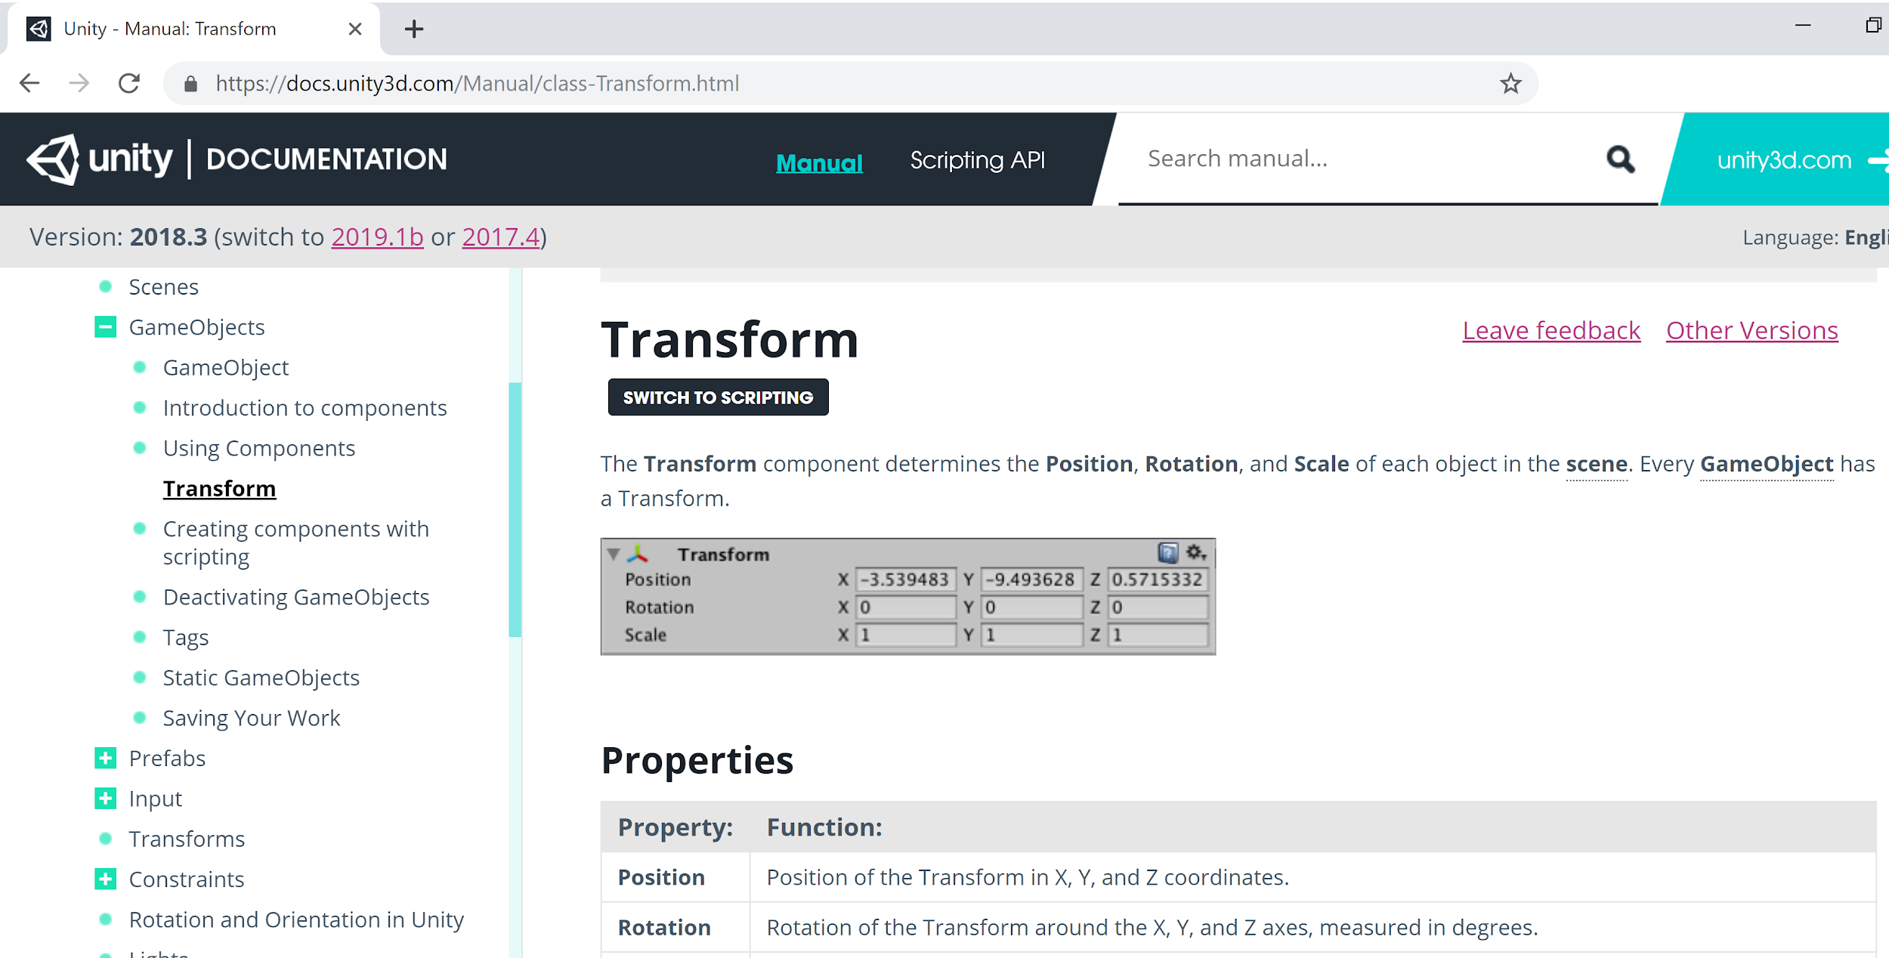
Notes:
Manual version of Unity Documentation
In MonoDevelop you can use shortcut keys Ctrl + ‘ (or Cmd + ‘ on a Mac) to access Unity’s documentation
In Visual Studio you can use shortcut keys Ctrl+Alt+M, Ctrl+H to access Unity’s documentation

Slide 38
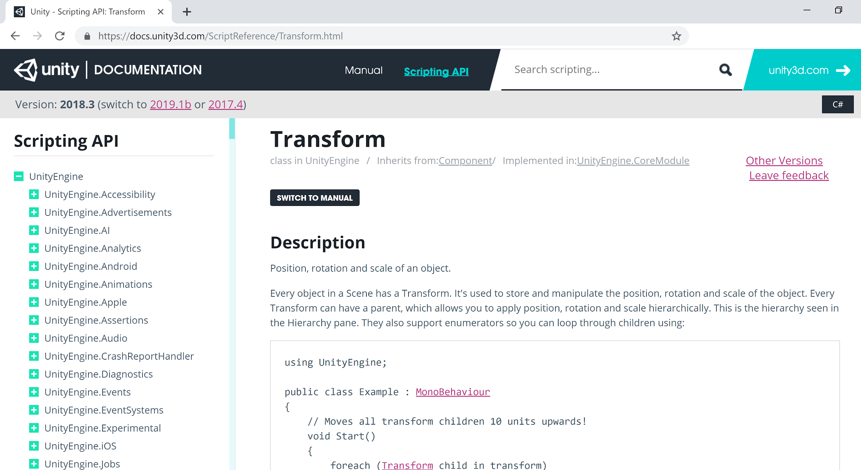
Notes:
Scripting version of Unity Documentation

Slide 39
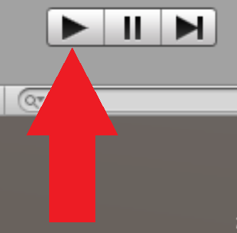
Test your app
Make sure the Magic Leap ML Remote is open
In Unity, click Magic Leap → Enable Zero Iteration
Press the Play icon in the toolbar and you will see your rotating cube
Notes:
Unity® projects require a few changes to make them compatible with the Magic Leap Remote. In particular, there is an “Enable Zero Iteration” command in Unity® that copies some helper libraries into your project and also relaunches the Unity® Editor in OpenGL mode. Check out Play Mode with Magic Leap Remote.

Slide 40
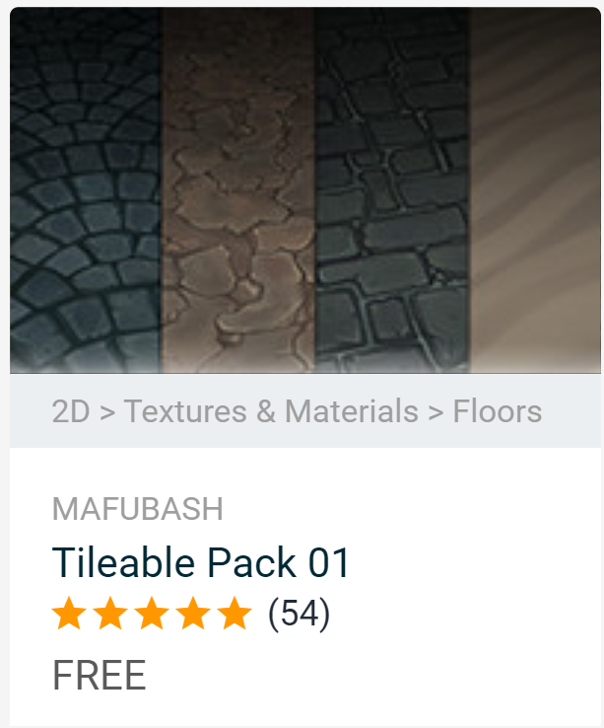
Asset Store
Import from the asset store
Tileable Pack 01
Notes:
Rendering in Unity is done with Materials, Shaders and Textures. There is a close relationship between Materials, Shaders and Textures in Unity. Materials are definitions of how a surface should be rendered, including references to textures used, tiling information, colour tints and more. The available options for a material depend on which shader the material is using. Shaders are small scripts that contain the mathematical calculations and algorithms for calculating the colour of each pixel rendered, based on the lighting input and the Material configuration. Textures are bitmap images. A Material may contain references to textures, so that the Material’s shader can use the textures while calculating the surface colour of an object. In addition to basic colour (albedo) of an object's surface, textures can represent many other aspects of a material’s surface such as its reflectivity or roughness. A material specifies one specific shader to use, and the shader used determines which options are available in the material. A shader specifies one or more textures variables that it expects to use, and the Material Inspector in Unity allows you to assign your own texture assets to these these texture variables.

Slide 41
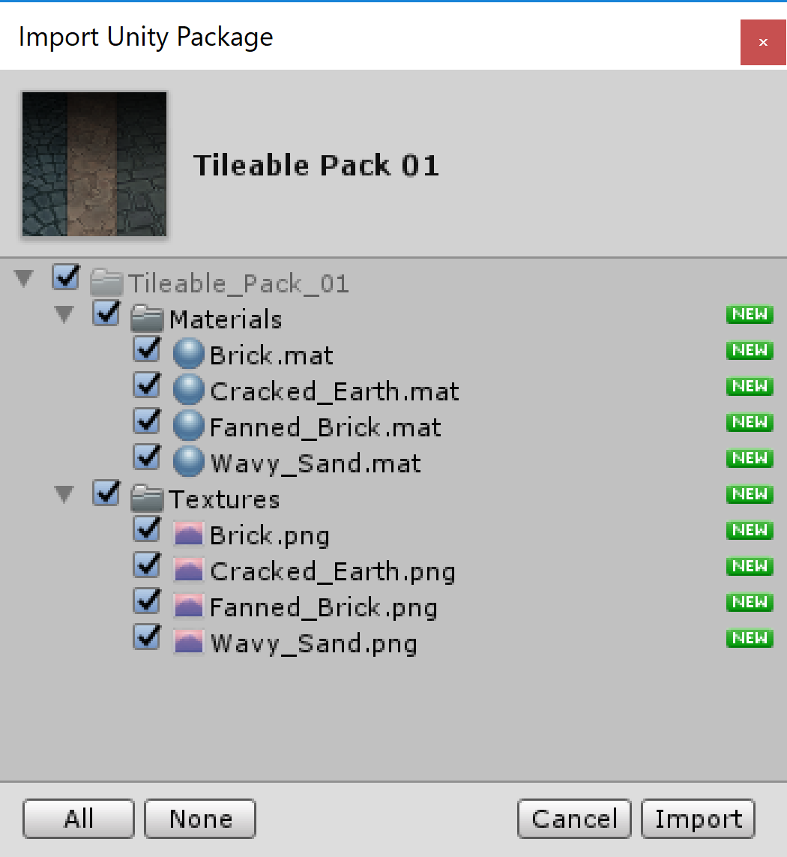
Notes:
Rendering in Unity is done with Materials, Shaders and Textures. There is a close relationship between Materials, Shaders and Textures in Unity. Materials are definitions of how a surface should be rendered, including references to textures used, tiling information, colour tints and more. The available options for a material depend on which shader the material is using. Shaders are small scripts that contain the mathematical calculations and algorithms for calculating the colour of each pixel rendered, based on the lighting input and the Material configuration. Textures are bitmap images. A Material may contain references to textures, so that the Material’s shader can use the textures while calculating the surface colour of an object. In addition to basic colour (albedo) of an object's surface, textures can represent many other aspects of a material’s surface such as its reflectivity or roughness. A material specifies one specific shader to use, and the shader used determines which options are available in the material. A shader specifies one or more textures variables that it expects to use, and the Material Inspector in Unity allows you to assign your own texture assets to these these texture variables.

Slide 42
Asset Store
In your Project Window, open the Tileable Pack 01 folder
Open the Materials folder
Select Brick and drag & drop onto your cube in the scene view or hierarchy window
Press Play to test
Notes:
Rendering in Unity is done with Materials, Shaders and Textures. There is a close relationship between Materials, Shaders and Textures in Unity. Materials are definitions of how a surface should be rendered, including references to textures used, tiling information, colour tints and more. The available options for a material depend on which shader the material is using. Shaders are small scripts that contain the mathematical calculations and algorithms for calculating the colour of each pixel rendered, based on the lighting input and the Material configuration. Textures are bitmap images. A Material may contain references to textures, so that the Material’s shader can use the textures while calculating the surface colour of an object. In addition to basic colour (albedo) of an object's surface, textures can represent many other aspects of a material’s surface such as its reflectivity or roughness. A material specifies one specific shader to use, and the shader used determines which options are available in the material. A shader specifies one or more textures variables that it expects to use, and the Material Inspector in Unity allows you to assign your own texture assets to these these texture variables.

Slide 43
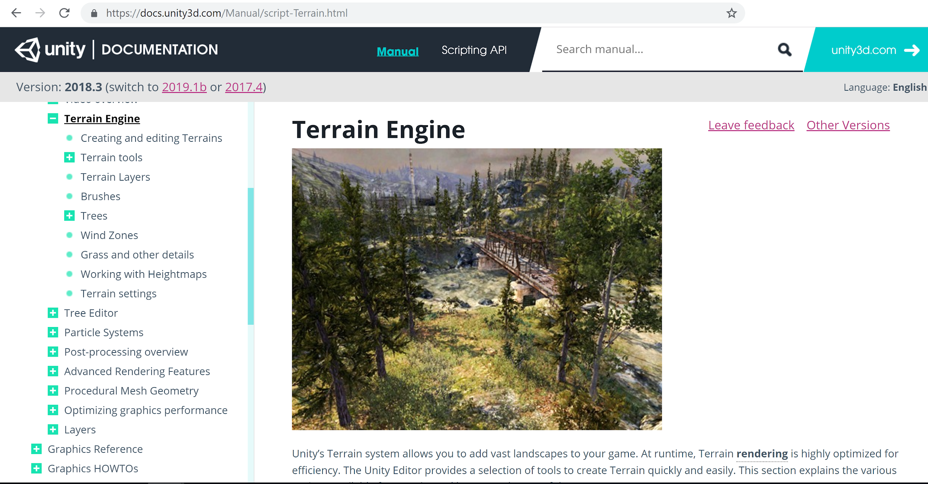
Notes:
Link to Andres’ slides: https://docs.google.com/presentation/d/1rC-6iPZgj-Mc8o6M0vhl5KMVQcDTy8r_W1lLVX0XTSc/edit?usp=sharing
https://docs.unity3d.com/Manual/script-Terrain.html
Unity’s Terrain system allows you to add vast landscapes to your game. At runtime, Terrain rendering is highly optimized for efficiency. The Unity Editor provides a selection of tools to create Terrain quickly and easily.
To add a Terrain GameObject to your Scene, select GameObject > 3D Object > Terrain from the menu. This also adds a corresponding Terrain Asset to the Project view. When you do this, the landscape is initially a large, flat plane. The Terrain’s Inspector window provides a number of tools to create detailed landscape features.
The four-icon toolbar provides options to sculpt and paint your Terrain, add trees and details such as grass, flowers, and rocks, and change general settings for the selected Terrain. For more information about each of these icons, see Terrain tools, Trees, Grass and other details, and Terrain Settings.

Slide 44
Build Settings
File → Build Settings...
Build And Run
Create a new subfolder titled “App”
Name your project and select Save
Notes:
Note: Before you can deploy apps to device, you must set up Magic Leap One for development to Enable MLDB access between your computer and the device, and to Allow untrusted sources.
When prompted on the ML1 to accept the Install certificate appears, select Yes with the Control.
You’ll first need to follow the steps from Magic Leap to set up your device for development. - Connect a device to your computer over USB. - On the device navigate to “Settings”, “Device”, and then “Creator Mode”.
Select the following: - Enable Creator Mode – Make Creator Mode options available for selection. - Allow Untrusted Sources – Install apps signed with a development certificate. - Enable MLDB Access – Allow Magic Leap Device Bridge to connect to your device.
Build Settings
Scripting backend is a framework that powers scripting in Unity. Unity supports three different scripting backends depending on the target platform: Mono, .NET and IL2CPP. Universal Windows Platform, however, supports only two: .NET and IL2CPP. You can switch between selected scripting backend in player settings.
IL2CPP is a fully-supported scripting back end that can be used as an alternative to .NET when building projects for Universal Windows Platform. When building a project using IL2CPP, Unity converts IL code from scripts and assemblies to C++ before creating a native binary. Refer to the Unity Manual page on IL2CPP for more information.
The .NET Scripting Backend is using Microsofts .NET to power scripting. Unlike other Unity platforms, Universal Windows Platform is not using .NET 3.5 Class Libraries profile, but rather a subset of .NET 4.5. This is due to Windows Store certification requirements. This means that the platform has some incompatibilities compared to other platforms, such as different plugin model and many missing types that are present in .NET 3.5 profile that Unity normally uses.

Slide 45
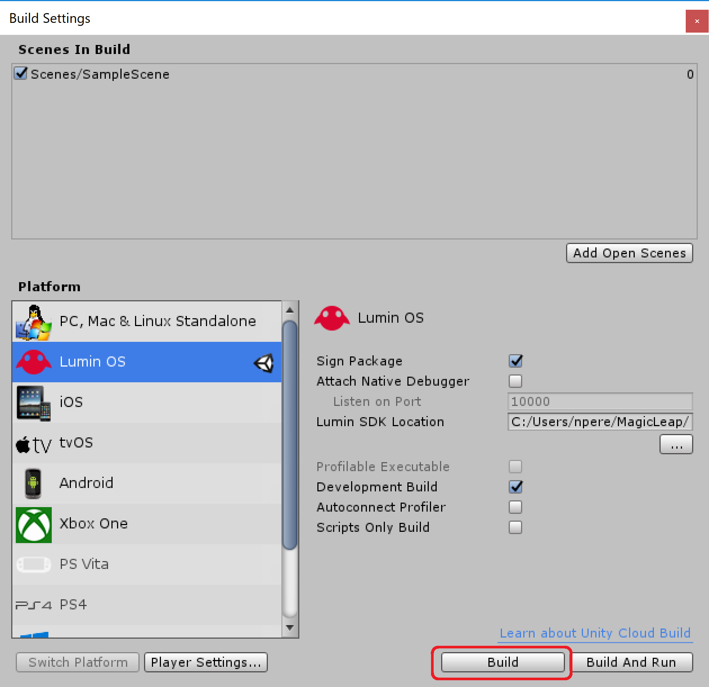
Notes:
Build Settings
Scripting backend is a framework that powers scripting in Unity. Unity supports three different scripting backends depending on the target platform: Mono, .NET and IL2CPP. Universal Windows Platform, however, supports only two: .NET and IL2CPP. You can switch between selected scripting backend in player settings.
IL2CPP is a fully-supported scripting back end that can be used as an alternative to .NET when building projects for Universal Windows Platform. When building a project using IL2CPP, Unity converts IL code from scripts and assemblies to C++ before creating a native binary. Refer to the Unity Manual page on IL2CPP for more information.
The .NET Scripting Backend is using Microsofts .NET to power scripting. Unlike other Unity platforms, Universal Windows Platform is not using .NET 3.5 Class Libraries profile, but rather a subset of .NET 4.5. This is due to Windows Store certification requirements. This means that the platform has some incompatibilities compared to other platforms, such as different plugin model and many missing types that are present in .NET 3.5 profile that Unity normally uses.

Slide 46
Q & A

Slide 47
Link to Slides:
goo.gl/o8e54h

